Slide 1

DG’S ENGAGEMENTS ON READING LITERACY
PURPOSE OF THE MEETING
MR HM MWELI

Slide 2
INTRODUCTION
“The illiterate of the 21st century will not be those who cannot read and write,
but those who cannot
learn, unlearn and relearn”.
ALVIN TOFFLER

Slide 3

Strengthen the alignment of Policy formulation and implementation from National to Provincial, District, School up to Classroom level.

Slide 4
Strengthen each other’s efforts in providing Quality Basic Education.

Slide 5
Getting different role players in the value chain of providing Quality Basic Education to close ranks in realizing the objectives and goals.

Slide 6
THEME
GETTING OUR NATION TO READ & LEAD

Slide 7
OBJECTIVES & OUTCOMES
OBJECTIVES | OUTCOMES
Reaffirm the Sector Sense of Strategic Direction | The Sector Sense of Strategic Direction has been reaffirmed
Rekindle and restore the efforts of the Sector in getting the nation to read and lead | The Sector’s efforts of getting the nation to read and lead have been rekindled and restored
Reminding School Principals of their critical role of people management | School Principals have been reminded of their critical role of people management
Making Building the Capacity of a Capable and Ethical Sector to be business of every School Principal’s business | Building the capacity of a capable and ethical sector has been made the business of every school principal
Placing the Upkeep and Maintenance of School Facilities on the radar of the day to day running of every school | Upkeep and Maintenance of School facilities have been placed on the radar of the day to day running of every school
Sharing lessons on leading Basic School Functionality to par Excellence from the Front | Lessons have been shared on Leading Basic Functionality to par Excellence from the Front
Heighten the focus for increased support on the Class of 2023 to perform better than the previous three classes | The focus for increasing support on the class of 2023 to perform better than the previous three classes has been heightened

Slide 8


Slide 9
DG’S ENGAGEMENTS ON READING LITERACY
SECTOR SENSE OF DIRECTION
MR HM MWELI

Slide 10

BASIC EDUCATION MANTRA
“By 2030, South Africans should have access to education and training of the highest quality, leading to significantly improved learning outcomes. The performance of South African learners in international standardised tests should be comparable to the performance of learners from countries at a similar level of development and with similar levels of access.”

Slide 11
STRATEGIC DIRECTION

Slide 12
HOW DOES THE SECTOR PLAN RELATES TO SDGs AND OTHER PLANS?
Sector plan
Action Plan to 2019: Towards the realisation of Schooling 2030 (access, redress, equity, inclusivity, quality, & efficiency)
NATIONAL DEVELOPMENT PLAN (NDP)
Independent analysis conducted by DBE
Medium Term Strategic Framework (MTSF)
DBE and PED five-year strategic plans
Periodic reports on progress in the sector (see e.g., 2011 and 2013 reports on DBE website)
Presidency
UNESCO 2030 AGENDA & CESA 2016-25 on the AFRICAN AGENDA 2063
External evaluations of key programmes
DBE and PED annual performance plans
DBE and PED annual reports
PED quarterly sector reports

Slide 13
2019-24 MTSF PRIORITIES
PRIORITY 7: A better Africa and world
7.
1.
PRIORITY 1:
Building a capable, ethical and developmental state
PRIORITY 6:
Social
cohesion
and safe
communities
2.
PRIORITY 2:
Economic transformation
and job creation
PRIORITY 5:
Spatial integration, human settlements and local government
5.
3.
PRIORITY 3:
Education, skills and health
PRIORITY 4: Consolidating the social wage through reliable and quality basic services
4.

Slide 14
MEDIUM-TERM STRATEGIC FRAMEWORK (MTSF)
2019-2024 OUTCOMES (EDUCATION)
Outcome 1: Improved school-readiness of children.
Outcome 2: 10-year-old learners enrolled in publicly funded schools read for meaning.
Outcome 3: Youths better prepared for further studies and the world of work beyond Grade 9.
Outcome 4: Youths leaving the schooling system more prepared to contribute towards a prosperous and equitable South Africa.
Outcome 5: School physical infrastructure and environment that inspires learners to learn and teachers to teach.

Slide 15
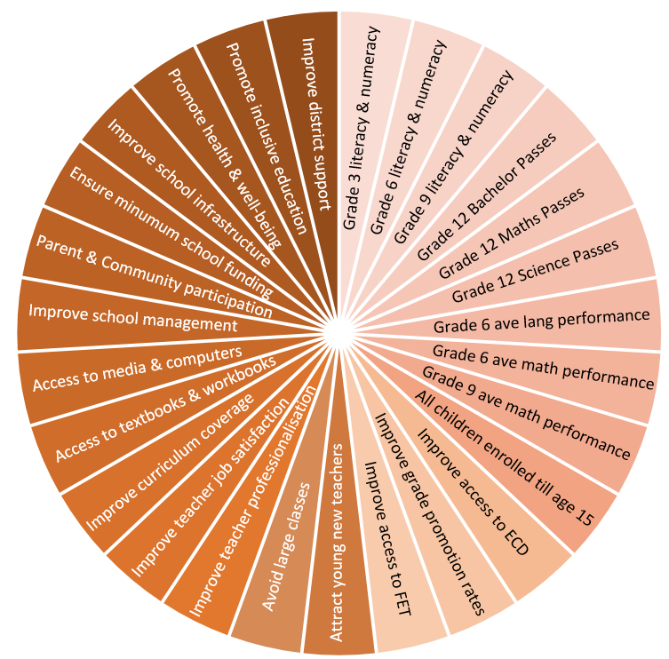

Action Plan to 2024:
Towards the realisation of Schooling 2030
(access, redress, equity, inclusivity, quality, & efficiency)
Goals 1 to 13:
Improved Learning Outcomes
Improve learning outcomes in Language, Mathematics and Science as measured in Grades 3, 6, 9 and 12
Ensure full access to compulsory schooling
Decrease grade repetition and retention
Improve access to Further Education and Training (FET) colleges
Improve quality of Grade R
Goals 14 to 27:
Interventions - the ‘how to Improve Learning Outcomes’
Apex priorities during the pandemic
Early Childhood Development
Infrastructure
Learning Losses

Slide 16

STRATEGIC THRUST
Action Plan to 2024:
Towards the realisation of Schooling 2030
(access, redress, equity, inclusivity, quality, & efficiency)
Five goals with an especially strong “action focus”.
Goals 1 to 13:
Improvement of Learning Outcomes
Improve learning outcomes in Language, Mathematics and Science as measured in Grades 3, 6, 9 and 12
Ensure full access to compulsory schooling
Decrease grade repetition and retention
Improve access to FET colleges
Improve quality of Grade R
Goals 14 to 27:
Support the improvement of Learning Outcomes
Increase teacher supply and improve teacher utilisation (incl. post provisioning)
Improve teacher development and job satisfaction
Increase curriculum coverage
Ensure minimum set of books, materials and equipment
Improve school management, funding and governance
Ensure adequate physical infrastructure
Ensure learner well-being, inclusive education, community linkages
Improve district functionality
Early Childhood Development
ICTs
Early Learning
3 Strategic Areas:

Slide 17
COUNCIL OF EDUCATION MINISTERS (CEM) PRIORITIES FOR THE SIXTH ADMINISTRATION
These priorities were approved by the Council of Education Ministers to lay a solid foundation for quality education, in support of improved reading and learning outcomes:
1. Improving foundational skills of Numeracy and Literacy, especially reading which should be underpinned by a Reading Revolution. | 4. Urgent implementation of two years of ECD before Grade 1, and the migration of the 0 - 4 year olds from the Department of Social Development to the Department of Basic Education.
2. Immediate implementation of a curriculum with skills and competencies for a changing world in all public schools (Three Stream Model, Fourth Industrial Revolution, Entrepreneurship, Focus Schools, etc.). | 5. Complete an integrated Infrastructure Development Plan informed by infrastructure delivery and regular maintenance which is resourced.
3. Deal decisively with quality and efficiency through the implementation of standardised assessments to reduce failure, repetition, and drop out rates and introduce multiple qualifications such as the General Education Certificate before the Grade 12 exit qualification. | 6. Work with Departments of Sport and Recreation, Arts and Culture, Health, and the South African Police Services to teach and promote Social Cohesion, Health and School Safety.

Slide 18
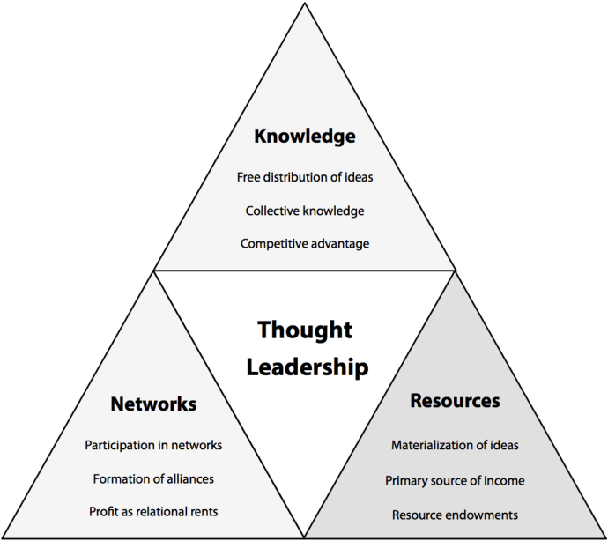
THOUGHT LEADERSHIP

Slide 19
TOP THREE
CHALLENGES
FACING SCHOOL
LEADERS
TODAY

Slide 20
CHALLENGE #1. IT’S TIME TO CHANGE!
“Across the developed world, a consensus is emerging. Schools may have delivered in the past, but they’re certainly not working for today, they were established in a different age and for a different set of purposes,” says Katherine Prince… Students nowadays think and learn very differently to past generations, yet we place them in schools based on a system for people of foregone eras that compels teachers to teach many students in the same way and at the same pace. Most of the students either are not learning at all or are learning in a very inefficient way.”
(Think Strategic White Paper 2020)

Slide 21
CHALLENGE #2 PERSONALIZED LEARNING
“Advances in neuroscience are predicting new notions of performance and cognition… Schools have been trying strategies like differentiation and inclusion for almost 30 years now and digital technology has been introduced into schools since the mid 80’s to revolutionize classrooms. Despite genuine efforts there are those who believe that Differentiation has failed and we have not maximized the potential of technology integration to meet the needs of individual students…”
“Christensen argues that the key to revolutionizing the classroom is not just by adding technology, but also to strategically consider the ways that technology is utilised to enhance learning. He believes that future schools must be student centric and adapt to the students’ different interests, types of intelligences and ways of learning.”
(Think Strategic White Paper 2020)

Slide 22
CHALLENGE # 3. EDUCATION FOR SUSTAINABILITY.
“The world and its resources are finite. According to Alan Atkisson, author and sustainability expert, we could reach a population of 9, 10 or even 12 billion. AtKisson and his team work with organizations, governments and schools around the world urging people to think long term about how we will all live within the boundaries of our planet and share prosperity and the right to be healthy and happy with all nations… Our aim must be to prepare our students to thrive in the 21st Century as citizens of the world contributing towards a just, peaceful and sustainable future.”
(Think Strategic White Paper 2020)

Slide 23
WHAT CAN BE DONE?

Slide 24
ACTION #1. BECOME A CHANGE AGENT
“Schools must become change agencies and activate teams of innovators, change agents and transformers to create the future for 21st Century learners. Sir Ken Robinson makes a very good case for changing education by changing one school at a time. It is time for all school leaders to take action. It’s time to build on the massive changes and innovation created by schools…”
(Think Strategic White Paper 2020)

Slide 25
ACTION #2 PERSONALIZED LEARNING.
“Katherine Prince, who is also the mother of a Generation Alpha child believes schools should radically personalize learning and offer places where the learning ecosystem adapts to each child’s needs:
individuals, not institutions, drive the flow of learning resources,
the learning ecosystem supports all students in accessing the right learning experiences and supports at the right time,
“school” takes many forms, with some kids attending schools that look a lot like many schools do today, some kids assembling custom mosaics of learning experiences, and everything in between,
physical learning hubs provide safe places for kids to go while functioning as portals to the broader community and to learning resources beyond the community’s boundaries, and
every child moves at his or her own pace while engaging in interest-based collaborative learning.”
(Think Strategic White Paper 2020)

Slide 26
ACTION #3 THINK SUSTAINABILITY AND THINK MINDFULNESS.
“Education is the key transformer to a more just and sustainable world…Sustainability is articulated in all aspects of the school learning community, through the five portals of governance, operations, networks and partnerships, teaching and learning, and buildings and grounds… By using a whole-school approach schools practice what they teach, and sustainability is reinforced in policy and actions; consequently, sustainability values are ‘caught, rather than taught.”
(Think Strategic White Paper 2020)

Slide 28
WHERE TO FROM HERE?

Slide 29
FEEDBACK TO:
The School Management Team (SMT)
Teachers and Non Teaching Staff
School Governing Body (SGBs)
Parents
Learners

Slide 30
ENTRENCH/INSTITUTIONALIZE
Data analysis to establish trends
Evidence Based approach
Prior Proper Planning
Accountability
Standard setting (Raising the bar)
Empirically Based Target Setting
Best Practice
Benchmarking with the best

Slide 31
CAPACITY BUILDING & TRAINING
Subject Advisor & other officials
School Management Teams (SMTs)
Teachers

Slide 32
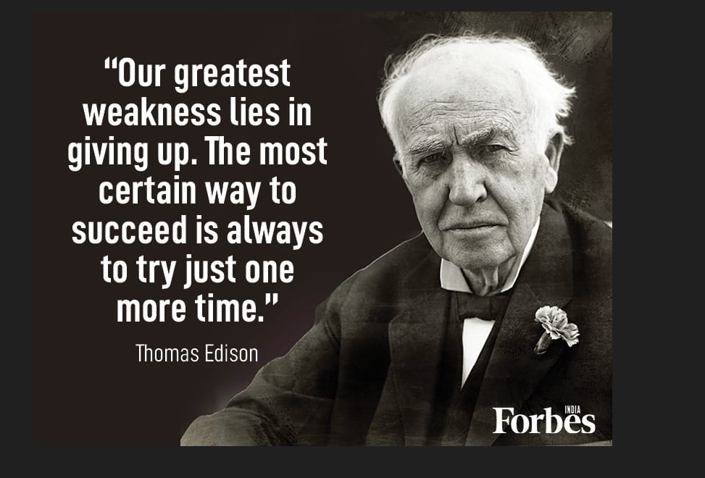
CONCLUSION

Slide 33

PARTING SHOT

Slide 34


