Slide 1
The Teaching Profession in our hands “Our voices and plight matter”
Inaugural Teachers Conference 2023
Teacher Agency, Leadership and Autonomy

Slide 2
Mokhudu Machaba Ngwanamago Primary school Mogodumo circuit Capricorn South District Limpopo
Presenter

Slide 3
Leadership in teaching
I personally believe that my leadership role emanates from roles and responsibility outlined in PAM.
Being a leader means:
Making decisions
Solving problems
Leading projects
Being Innovative
Collaborating with stakeholders
3

Slide 4
Teacher agency can be attributed to 7 elements that can contribute to effective learning and teaching.
Voice
Choice
Engagement
Motivation
Ownership
Purpose and
Self driven
Teacher Agency

Slide 5
Autonomy
In sociology and philosophy agency refers to autonomy or the extent to which an entity is free to exert its own will, independent of other entities.
The statement above allows for key words in the topic to work interchangeably
With a healthy amount of teacher autonomy, students are more likely to feel like their teachers are there to teach, not implement or comply. Therefore, they're more likely to consider ideas, not rehearse answers.
Autonomous teachers have the freedom to plan and practise teaching activities. Also, they have an important role in decision making about critical issues in their duties
5

Slide 6
How I took my role as a teacher to be my voice and plight
I became resourceful in an under-resourced classroom .
By contextualizing my lessons to relate to my learners environment
By improvising resources and becoming innovative.
By implementing ideas from my learners
Empowering Communities
I initiated programs to train community members on ICT and collaborated with institutions of higher learning to certify them
I trained my peers from school to national level either through my personal initiative or collaborating with other stakeholders
Professional Development
I took an initiative to develop myself guided by the ISPFTEPD
Through that I took courses that enabled me to improve my skills
I entered competitions to showcase the work I am doing with my learners
6

Slide 7
What are the guiding tools of trade?
Department of Basic Education policy documents :
CAPS Subjects policies
NPR
NPPPPR
White paper 6
White paper 7
Just to mention few
More guidelines on a wider perspective
NDP 2030
Emphasizing on (5. Inclusive Rural Economy, 7. Quality Education, 9. Social protection)
SDG’s
Emphasizing on ( 4 Goals)
7

Slide 8
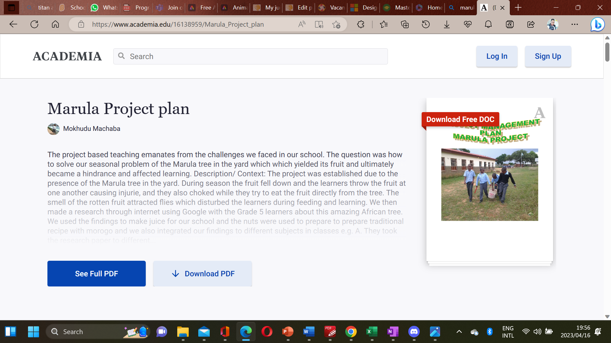
Initiated projects as an agent of change
2011 | 2012 | 2013 | 2014 | 2015
Marula Project | Paper doll | Song miming Singing and Dancing |  | Minecraft Offline version from Code.org
(DOC) Marula Project plan | Mokhudu Machaba - Academia.edu | This is one of the project that tested our ICT integration into curriculum Lifekills Project Visual Art This is the first project where I used my single cell phone for research | This project was a Lifeskills Performing art project Learners used SongSmith to create their own recording and beats |  | I introduced my learners to the code.org platform where they created their own projects

Slide 9
Initiated projects as an agent of change
2016 | 2017 | 2018 | 2019 | 2020
Seshego Project (Traditional way of preserving seeds) | Dance club and Cybersecurity program | Content Creation for Foundation phase on HL | Coding and robotics using Code.org and Scratch | COVID HIT us Training peers online.
This was Creative Arts project which integrated other subjects In this project we were solving a problem of seeds decay prior the next harvest | Learners were introduced to Cybersecurity course through Lifejourney website. I was educating my learners on Online safety | I started the content creation as one of intellectual property I am building. I am now owning a website where I hope to collaborated with my learners, peers and parents | In collaboration with SchoolNetSA and Bellamatrix ICT Foundation I introduced my learners to scratch coding | Engaged peers on to integrate ICT into curriculum Hosted my fellow Global teacher Prize top 50 finalist to share their good practices and invited local teachers to attend

Slide 10
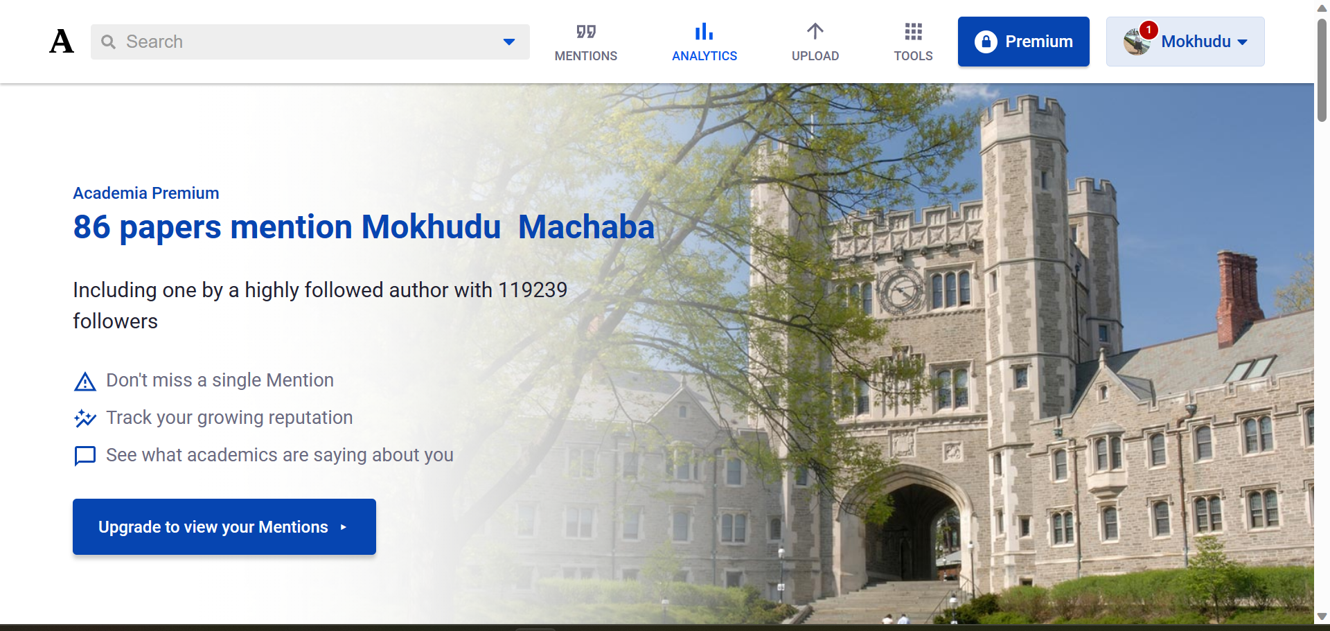
High valued projects that I am looking forward to establish an economic empowerment for the community

Slide 11
School Improvements and Development

Slide 12
CPSI SPECIAL MINISTERIAL AWARD
The school was awarded the Special Ministerial Award in 2016 and the money was used to install the projector , the first Interactive whiteboard and the laptop
12

Slide 13
Pilot school
The Limpopo Department of Education offered 52 laptops towards the coding and robotics program and the school was declared a pilot school.
13

Slide 14
Peer Coaching and Training

Slide 15
School based training
I have trained over 100 schools on ICT Integration into curriculum in collaboration with Microsoft, SchoolNetSA, Bellamatrix ICT Foundation etc.
15

Slide 16
Circuit Based Training
I have initiated trainings in my circuit to train my peers and seniors on ICT Integration intom curriculum.
16

Slide 17
District Engagement
I have engaged in district NTA advocacy, coaching and mentoring since 2018.
I have assisted in compilation of district presentation for the National districts awards
17

Slide 18
Provincial Engagenments
I served in the district ICT committee for digitizing IQMS from being paperless to electronic.
I have coached and mentored NTA candidates for national adjudication,
18

Slide 19
Commuinity Development

Slide 20
Computer literacy program for Women and Youth
I have trained community members on computer literacy and managed to certify them through higher institutions of learning through collaborative programs
20

Slide 21
Extended programs
Training teachers outside of work either face to face or through online platforms by hosting mini conferences.
21

Slide 22
Recognition from private sector
22

Slide 23
ISPA SUPER TEACHER SINCE 2009
From 2009 I have been showcasing my learners work.
I have been awarded three times as a champion.
23

Slide 24
MIEE EXPERT
2015 I Represented South Africa at the Microsoft Campus in Redmond USA
My team got position overall 2 on overall permance out of 43 teams
24

Slide 25
Recognitions and Awards
Nationally and Globally
25

Slide 26
National Teacher Awards
Excellence in Primary school teaching 2018
26

Slide 27
Global Teacher Price
Top 10
27

Slide 28
On the teachers matter platform I am regarded as one of changemakers Globally
28

Slide 30
THANK YOU
Mokhudu Machaba
+27 769645416
info@mokhuducreations.net
https://mokhuducreations.net

