Slide 1
The Teaching Profession in the Hands of the Teacher
Curriculum
&
Classroom Practice
The Centrality of the Teacher
Mr. Khomo S. S,
Umlazi District Chief Education Specialist , TD

Slide 2
The Teaching Profession in the Hands of the Teacher
I have deliberately paraphrased the THEME
Logical Question : What Teacher is the teaching profession
in the hands of?
[ The Character / DNA ]
The THEME is about a teacher ( all levels ) whose
performance mandate is anchored in Vision & Revolution,
NOT on routine & compensation.

Slide 3
The Teaching Profession in the Hands of the Teacher
The THEME is about teachers who interrogate their daily
classroom interactions with learners with these questions:
1. Am I appointed to PERFORM or is performance a CHOICE?
2. Whose subject am I teaching in the classroom?
3. Are my clients ( learners ) in my Class / my school
because I am the BEST option or the ONLY option?
4. Do I ( my school ) exist in the profession for statistical
reasons or for revolutionary cause? [ Living beyond Existence ]

Slide 4
The Teaching Profession in the Hands of the Teacher
Staffroom
Keeping the IC in our line of sight - building a capable classroom
SMT
Classroom Focus :
T-L-C
Instructional Core
Connections that Matters :
How am I connecting with the TLC in the critical unit of curriculum delivery?[ Classroom]
How am I connecting as an INFLUENCER with the machinery of curriculum management?
How am I connecting with the village hopes & scaffolding the aspirations to reality?
Connections

Slide 5
The Teaching Profession in the Hands of the Teacher
THE TEACHER AT THE CENTRE OF THE CONNECTIONS
Common Cause : PAM: JD for Teachers: Paragraph 3.1.1 :
To engage in classroom teaching
which will foster purposeful
progression in learning – No Ambiguity
What does Purposeful Progression mean?
It must be defined through the organisational ( personal ) vision &
organisational ( personal ) revolution --
( Revolution : A turn around in the way of thinking & doing things )

Slide 6
The Teaching Profession in the Hands of the Teacher
WHAT DOES INSTRUCTIONAL CORE LOOK LIKE TO THE TEACHER
IN WHOSE HANDS THE TEACHING PROFESSION IS?
1. It is a practice of Intentional rather that routine classroom interaction
2. It is about reinforcing concept understanding for learners rather than
ensuring alignment with the ATP – tick box exercise
[ Curriculum coverage is NOT about the teacher but the learner ]
3. It is about conducting MORE assessments FOR learning rather that
assessment of learning [ Spend time on informal to master the formal ]
4. It about being TRUE to the teaching cycle of Teach-Assess-Analyze-Remediate

Slide 7
The Teaching Profession in the Hands of the Teacher
The 2022 International Teachers’ Day Theme :
Transformation of Education begins with the Teacher
What is the relevance of this theme to the THEME for this Conference and the Sub-theme for this parallel Session : Curriculum & Classroom Practice
Unless the Education Sector is intentional in investing in the Teacher as the centre piece for Curriculum Delivery, the rest is all but a pipe dream.

Slide 8
The Teaching Profession in the Hands of the Teacher
In an attempt to prepare Teachers ( All levels ) for the changing
environments, the Minister of Education stated :
Speech by Minister, 20 Jan. 2022 : “we are increasingly prioritising interventions,
improvement programmes, and policies that target improved quality of learning
and teaching; and implementing accountability systems to ensure that quality
outcomes are achieved right through the basic education system. [ Your school incl. ]
Given South Africa’s divided past, and the continued negative impact of
socio-economic realities on learning outcomes, the interventions and improvement
programmes we continuously introduce, are an attempt to counteract the
unintended negative impact and learning deficits on learner attainment.

Slide 9
The Teaching Profession in the Hands of the Teacher
CURRICULUM TAKE-AWAYS
Curriculum is to be viewed as a continuum & as such the GET /FET
mentality needs interrogation --- the lopsided investment regime
# Purposive Interventions : Are the interventions that teachers make
intentional or interventions for the sake of intervention
# Myths & Misconceptions : a) Matric results are made in Grade 12
b) Learners in lower grades still have enough time to learn and catch up
c) Results will come whether we intervene or not – The system is in place
# Disjuncture : Teachers teach at one level and assess at another level
QUESTION : HOW ARE TEACHERS FACTORING THESE MATTERS INTO THEIR PLANNING

Slide 10
CRITICAL PRONOUNCEMENTS
ARGUMENTS RAISED :
CD, Dr. Makhathini : Curriculum is to be viewed as a continuum &
as such the GET /FET mentality needs
interrogation --- the lopsided funding regime
# Purposive Interventions : Are the interventions that districts
intentional or interventions for the sake of intervention
# Myths & Misconceptions : a) Matric results are made in Grade 12
b) Learners in lower grades still have enough time to and catch up
c) Results will come whether we intervene or not – system in place
# Disjuncture : Teachers teach at one level and assess at another level
QUESTION : HOW ARE DISTRICTS FACTORING THESE MATTERS INTO THEIR PLANNING

Slide 11
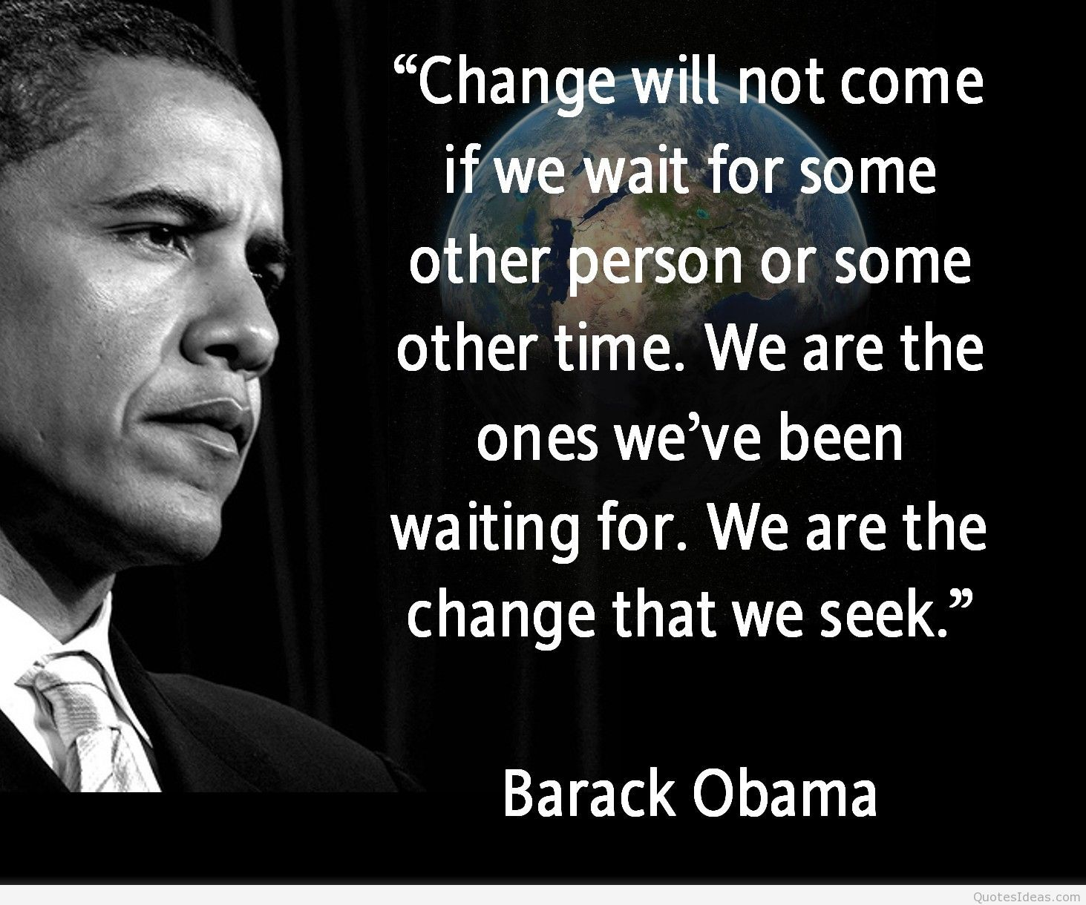
The Teaching Profession in the Hands of the Teacher

Slide 12
The Teaching Profession in the Hands of the Teacher
If Not Us then Who?
If Not Now then When?
Malcom X
The Teaching Profession is in the Hands of Teachers

