Slide 1
UNDERSTANDING THE ROLE OF SACE
Webinar
Ella Mokgalane
09 May 2022

Slide 2
PURPOSE OF THE SESSION
Orientation on the role of the South Council for Educators (SACE)
Know, understand and embrace your professional body.
Familiarize you with the SACE mandates.

Slide 4
TEACHERS AND PRINCIPALS ARE AT THE EPICENTER OF TRANSFORMATION AND ACHIEVING THE COUNTRY’S LEARNING OUTCOMES.

Slide 5
PROFESSIONALISATION OF THE TEACHING PROFESSION Building Capable, Ethical, and Inclusive Teaching Profession, Schools, Educators and SCHOOL LEADERS

Slide 6
Building Trust, Credibility, Integrity in The Teaching Profession/Schools/School Leadership

Slide 7
VISION Inspiring a Credible Teaching Profession.
MISSION To protect the integrity of the teaching profession through the maintenance of the professional and ethical standards.

Slide 8
VALUES OF THE TEACHING PROFESSION This is what it means to be a professional and ethical educator/school leader in the South African teaching profession. Professional Identity – values, disposition, nature
ACCOUNTABILTY
DIGNITY
QUALITY
RESPECT
RESPONSIBILITY
TRANSPARENCY
TOLERANCE
INTEGRITY
SERVICE ORIENTED
Values-based teaching profession, conduct, leadership
Values are an essential component of a professional culture and commitment to the teaching profession

Slide 9
VALUES OF THE PROFESSION IN YOUR SCHOOL
Are the spectacles we use to view the personal, ethical and professional issues confronting us in out of our working environment.
Promotes teachers treating others with respect, dignity and integrity.
Forbid the violation of others’ rights.
Guides our moral compass in distinguishing between right and wrong, good and evil
Inform our ethical competence and judgements.
Guides decision making when confronted with ethical dilemmas and difficult ethical situation.

Slide 10
ALL MEMBERS OF THE TEACHING PROFESSION MATTER IN INSPIRING A CREDIBLE TEACHING PROFESSION COLLABORATIVELY WITH SACE Quality and Effective Teaching and Learning

Slide 11
SACE HISTORICAL BACKGROUND

Slide 12
PRE-1994
Professional regulation of the teaching profession was racially segregated and targeted mainly at the white teachers only.
The teaching profession was regulated by the South African Teachers Council for Whites (STCW) as mandated by the South African Teachers Council for White Act (Act, No. 116 of 1976).
This Act was repealed by the National Education Council Amendment Act of 1986 that established the National Education Council for the Whites along with the four Federal Councils that were divided into the four apartheid colonies – Cape, Orange Free State, Transvaal and Natal.
In this case, the White teachers in the Gauteng province were regulated by the Transvaal Federal Council (TFC) for White teachers only, so was the Cape, Orange Free State and Natal Teachers councils for the Whites.

Slide 13
SACE HISTORICAL BACKGROUND
1994
Separation of SACE from ELRC (teacher professionalisation matters from conditions of service)
1995
SACE is Launched
Two mandates
1997
Extension of SACE mandate to include Professional Development of Teachers
Notice of SACE Recognition by Minister of Education
Registration of teachers
Existence through an ELRC Resolution
Ensuring that teachers adhere to the Code of Professional Ethics
Existence in terms of a chapter in the Educators Employment Act (1998)
Official Recognition of SACE by the Minister of Education
SACE is conceived as part of the Education Labour Relations Council (ELRC)

Slide 14
SACE LEGISLATION AND POLICY ENVIRONMENT

Slide 15
NATIONAL DEVELOPMENT PLAN
NDP: Vision 2030
Professional Standards
Professional Certification
Quality Professional Development Provisioning

Slide 16
SACE ACT NO.31 OF 2000 (Enabling / Founding Legislation) The objects of the SACE Act are: (a) to provide for the registration of educators; (b) to promote the professional development of educators; and (c) to set, maintain and protect ethical and professional standards for educators, by means of the functioning of the council.

Slide 17
REGULATORY FRAMEWORKS
Determining Entry into all levels of the Teaching Profession
Setting and Enforcing the Professional Standards
Managing a System for Continuing Professional Teacher Development
Setting and Enforcing Ethical Standards

Slide 19
APPLICABILITY OF THE SACE ACT
The SACE Act applies to educators appointed-
in terms of the Employment of Educators Act, 1998 (Act No.76 of 1998);
in terms of the South African Schools Act, 1996 (Act No. 84 of 1996):
in an independent school; 5
in terms of the Further Education and Training Act, 1998 (Act No. 98 of
1998) as amended;
at a TVET institution;
at a Community Education and Training Centre.

Slide 20
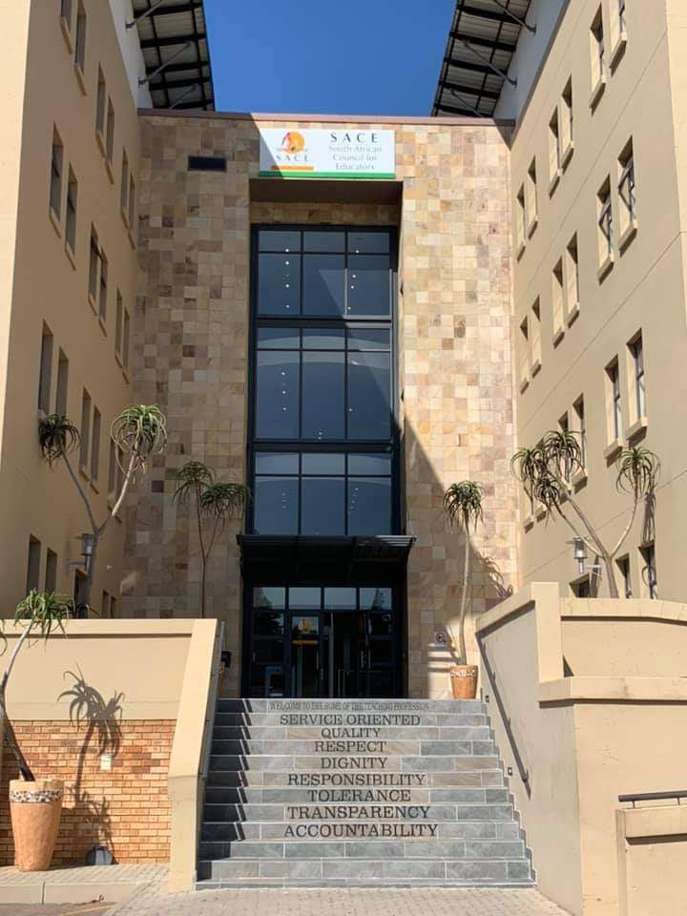
SACE IS THE HOME OF BOTH SCHOOL AND OFFICE-BASED EDUCATORS, TVET/CET COLLEGE LECTURERS, ECD PRACTITIONERS AND STUDENT TEACHERS

Slide 21
LEGISLATIVE AND POLICY ENVIRONMENT
SDG 4
Education International and UNESCO Framework for Professional Teaching Standards
Global Teacher Prize
EI Professional Ethics Declaration
NDP: Vision 2030
National Development Plan
ILO/UNESCO Recommendation Concerning the Status of Teachers
05 Oct 1966
SACE Professional Teaching Standards and Code of Professional Ethics
SACE Act, 2000
South African Council for Educators Act, 2000 as amended
NQF Amended Act, 2019
National Qualifications Framework Act, 2008
NPFTED, 2007
National Policy Framework for Teacher Education and Development South Africa
ISPFTED, 2011
Integrated Strategic Planning Framework for Teacher Education and Development in South Africa, 2011–2025
Employment of Educators Act, 1998
The Revised Personnel Administrative Measures, 2016
South African Schools Act, 1996
The Revised Policy On The Minimum Requirements For Teacher Education Qualifications, 2015
Education Labour Relations Council and PSCBC Resolutions
Policy on Minimum Requirements for Programmes Leading to Qualifications in Higher Education for Early Childhood Development Educators, 2017

Slide 22
Source of SACE Funds as Per the SACE Act, as Amended
19. (1) The funds of the council consist of—
(aA) money appropriated by Parliament (BELA Act of 2011): Not Explored as yet in terms of funding from the NRF and as per the DORA
(a) compulsory fees : Teachers’ Levy not collected directly by SACE but through the State
(b) money received from donations, contributions, interest or fines; and
(c) other money received by the council from any other source : CPTD system Grant

Slide 23
SACE REPORTS TO THE MINISTER OF BASIC EDUCATION SACE IS ALSO ACCOUNTABLE TO PARLIAMENT

Slide 24
SACE AS PART OF THE INTERNATIONAL COMMUNITY

Slide 25
SACE IS A MEMBER OF THE AFRICA FEDERATION OF TEACHER REGULATORY AUTHORITIES (AFTRA)
Professionalising the teaching profession in the continent
Meets 2 -3 times year (including annual teaching and learning conference)
Influencing African states to establish professional teaching councils
Professional Teaching Councils in Africa
South African Council for Educators (AFTRA Presidency – Councillor Mabutho Cele, Administrative Office)
Teacher Registration Council of Nigeria (Academic Office)
Ghana National Teaching Council
Zambian Teaching Council (Secretariat Office)
Botswana, Zimbabwe, Namibia are in the process of establishing their Councils
Other Countries – Teaching Service Commissions run by Ministries of Education

Slide 26
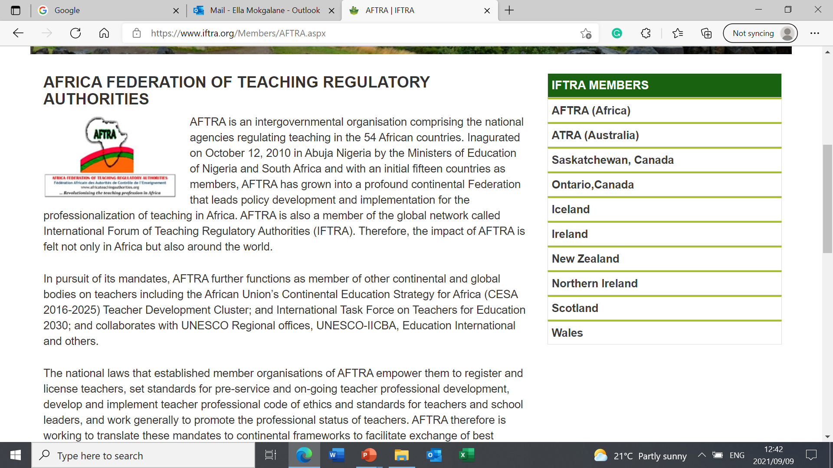

Slide 27
INTERNATIONAL REGULATORY AUTHORITIES
International Forum of Teacher Regulatory Authorities (IFTRA)
AFTRA is a member of IFTRA
SACE is a member through AFTRA
Biennial Conferences - Hosting on rotational basis
SACE hosted in 2010

Slide 28
Letter of Good Professional Standing
If you are planning on teaching outside South Africa the authorities in that country will likely require proof of your registration in South Africa.
The Letter of Professional Standing (LOPS):
States that you are registered with SACE.
confirms that you are a qualified teacher
Confirms that your registration was not suspended, revoked or cancelled for any reason
Confirms your participation in the CPTD system.
We would urge you to check with the specific country to establish exactly what the requirements are, if you choose to teach outside South Africa.
The SACE Registration requirements will provide you with some requirements in applying for the Letter of Good Professional Standing.

Slide 29
UNDERSTANDING SACE AS A PROFESSIONAL REGULATORY BODY IN THE TEACHING PROFESSION

Slide 30
SACE AS AN ORGANISATION / INSTITUTION

Slide 31
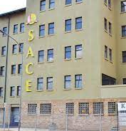
240 Lenchen Avenue, Centurion

Slide 32
SACE PROVINCIAL OFFICES
CURRENT PROVINCIAL OFFICES
Kwazulu-Natal - Durban
Free State – Bloemfontein
POSSIBLE NEW OFFICES / MOBILE OFFICES
Limpopo – Polokwane
Eastern Cape – East London
Western Cape – Not yet operational (Municipality requirements)
MP, NW, and NC

Slide 33
SACE AS A PROFESSIONAL REGULATORY BODY

Slide 34
Regulation is used in this context as a specific form of governance to regulate educators through regulatory tools, such as, professional standards, ethical standards, rules, codes through some public entities and agencies
An organisation (SACE) with individual members (teachers) practicing a profession (teaching profession) or occupation in which the organisation maintains an oversight (regulation) of the knowledge, skills, conduct and practice of that profession or occupation.
Regulatory Tools / Instruments
Determining Entry into the Profession, Developing and Enforcing the Professional Standards and Ethical Standards.

Slide 35
PROFESSIONAL STATUTORY BODIES
Mandatory Bodies / Membership (Through professional registration)
Established in terms of an Act of Parliament (SACE Act)
Derives its power, authority and mandate from the Act (SACE Act)
Established to perform specific functions which a government considers effectively performed outside a traditional departmental executive structure (Agencification)
Regulate a profession in line with the Act (Regulatory Frameworks)

Slide 36
Professional Self-Regulatory
One of the regulation strategies that involves a process whereby a professional body or regulators is/are given delegated authority through the legislation, by parliament, is to:
set the professional and ethical standards for the profession; and
be able to implement, monitor and enforce them when they are breached.
Governed by the “Profession for the Profession” / “Teachers for the Teachers” – 60% majority in Council
30 members and 18 of them are members of the organised teaching profession and it is led by a member of the teaching profession.
12 out of the 18 members are from SADTU, 2 NAPTOSA, 1 SAOU, 1 PEU and 2 NATU (based on the ELRC weight votes at the end)
Educators form part of the 18 members of the organised teaching profession – as represented by their five national teachers' unions recognised by the Education Labour Relations Council.
Self-funding through members' monthly levies because SACE is a self-regulatory professional body, except for the CPTD Management system which is funded directly from fiscus – SACE’s Main Source of Funding – R16-50 Monthly (Reviewed Periodically).

Slide 37
SACE ACCOUNTING AUTHORITY (Governance Structure – The Council)

Slide 38
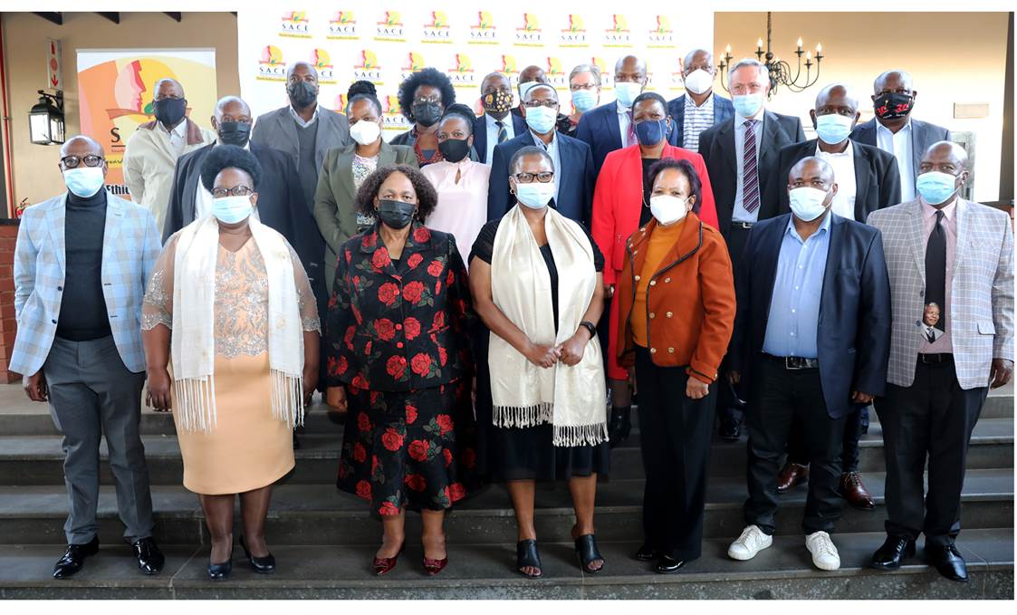
COUNCIL MATTERS IN INSPIRING A CREDIBLE TEACHING PROFESSION Efficient and Effective Governance

Slide 39
Council Composition : 4-Year Term of Office
The Chairperson
18 educators collectively nominated by the organised profession
Five persons nominated by the Department of Education;
Two persons nominated by the national associations representing school
governing bodies contemplated in section 20(3) of the South African Schools Act, 1996 (Act No. 84 of 1996);
One person nominated by the Council on Higher Education established by section 4 of the Higher Education Act, 1997 (Act No. 101 of 1997);
One person nominated by the councils of further education and training institutions contemplated in section 8 of the Further Education and Training Act, 1998 (Act No. 98 of 1998)
One person nominated by national bodies representing independent or private Institutions recognised by the Minister: and
The Chief Executive Officer of the council.

Slide 40
Council Composition : 4-Year Term of Office
SACE Constituencies nominate people to serve in Council for four years
Vetting and Screening takes place (Conduct and Qualifications)
List and CV and vetting documents sent to the Minister
Minister Appoint and 29 Councillor and the 30th one is the CEO as per the SACE Act
Councillors get inaugurated by the Minister
In its Inaugural Meeting, Council nominate five names and send them to the Minister to appoint one out of the five as a Chairperson of Council
Once the Chairperson is Appointed, Council nominate one person to be the Deputy Chairperson of Council, who automatically becomes the Deputy Chairperson of Council, in line with the SACE Act.
The current term of office started on the 01st August 2017 and came to an end on the 31st July 2021.
The Minister will inaugurate the new Council for 2021 – 2025 terms of office, on the 18th August 2021.

Slide 41
Council Composition : 4-Year Term of Office
SACE Constituencies nominate people to serve in Council for four years
Vetting and Screening takes place (Conduct and Qualifications)
List and CV and vetting documents sent to the Minister
Minister Appoints 29 Councillors and the 30th one is the CEO as per the SACE Act
Councillors get inaugurated by the Minister
In its Inaugural Meeting, Council nominate five names and send them to the Minister to appoint one out of the five as a Chairperson of Council
Once the Chairperson is Appointed, Council nominate one person to be the Deputy Chairperson of Council, who automatically becomes the Deputy Chairperson of Council, in line with the SACE Act.
The current term of office started on the 01st August 2017 and came to an end on the 31st July 2021.
The Minister inaugurated the new Council for 2021 – 2025 terms of office, on the 18th August 2021.

Slide 43
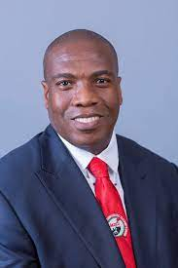
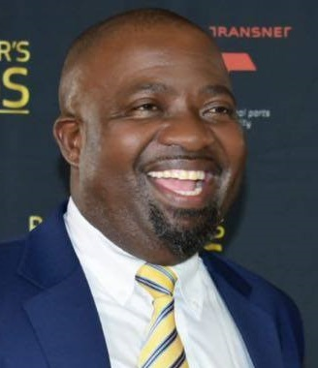
SACE Council Chairperson –
Mabutho Cele
SACE Council Deputy Chairperson – Nkosiephendule Ntantala

Slide 44
SACE Mandate Affecting You and Powers and Duties of Council

Slide 45
PROFESSIONAL REGISTRATION

Slide 46
Becoming, Being, and Growing as a South African Educator

Slide 47
Becoming A Provisionally Registered Teacher In the South African Teaching Profession PROFESSIONALISING INITIAL TEACHER EDUCATION AND STUDENT TEACHERS

Slide 48
PROFESSIONAL REGISTRATION OF STUDENT TEACHERS
PROVISIONAL REGISTRATION
FOR STUDENT TEACHERS ONLY

Slide 49
Regulating and professionalising the practice of teaching / Work Integrated Learning in Schools

Slide 50
PROVISIONAL REGISTRATION PROVIDES AUTHORITY TO:
Define the scope and boundaries of practice for student teachers protecting them:
Professional responsibilities relevant to and appropriate for student teachers
The conditions under which student teachers may practise their profession
Practice the scope of teaching for purposes of observing, practising and learning to teach during school experience / teaching practice
Understand Fitness-to-practice in context
Responsibility, Accountability, and clarifying who is Inloco Parentus in classrooms

Slide 51
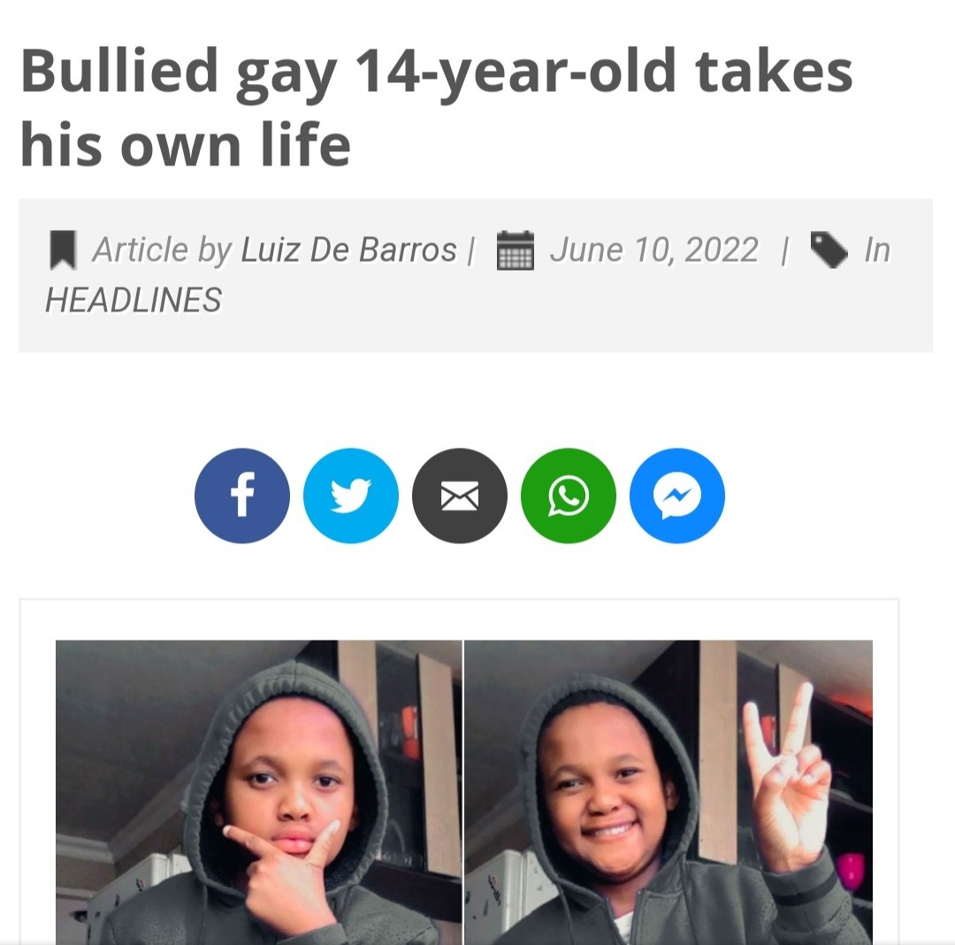
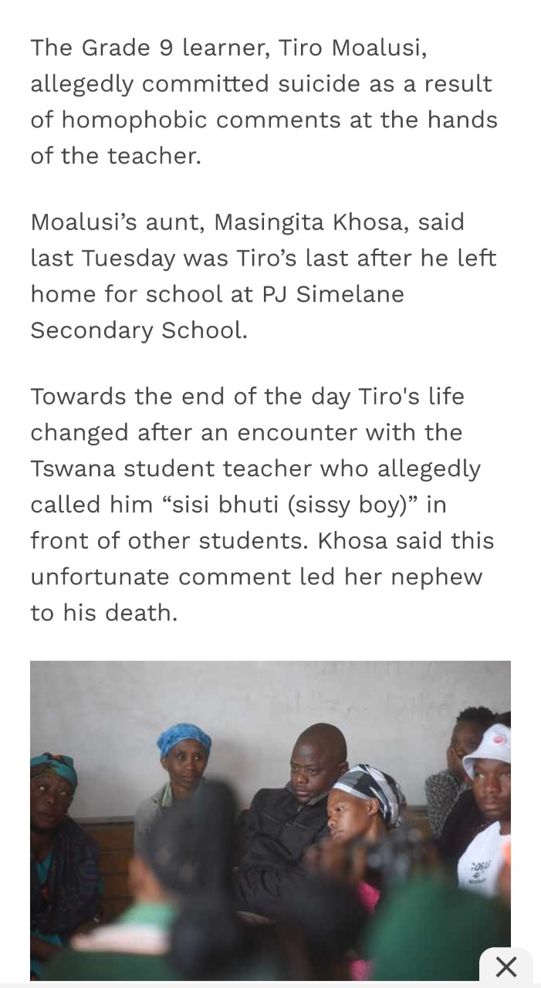
STUDENT TEACHER BARRED FROM ENTERING THE TEACHING PROFESSION, FLAGGED ON THE SACE ROLL OF TEACHERS

Slide 52
UPHOLDING ETHICAL STANDARDS DURING TEACHING PRACTICE AS A STUDENT TEACHER AND PROSPECTIVE TEACHER DRAFT Code of Professional Ethics for Student Teachers

Slide 53
Being – As a Newly Qualified Fit-to-Practice/Teach Educator

Slide 54
FROM PROVISIONAL TO FULL REGISTRATION STATUS

Slide 55
NEWLY QUALIFIED TEACHERS (NQT) Induction and Full Registration Status
Professional Certification - Certify the newly qualified educators upon the completion of the induction process
Awarding of full registration status And designation as a professionally certified NQT.

Slide 56
REGISTRATION OF PROFESSIONAL EDUCATORS
must determine minimum criteria and procedures for registration or provisional registration;
must consider and decide on any application for registration or provisional registration; - Two types of Registration (Provisional and Full)
must keep a register of the names of all persons who are registered or provisionally registered;
must determine
the form and contents of the registers and certificates to be kept, maintained or issued in terms of this Act, the periods within which they must be reviewed
may prescribe the period of validity of the registration or provisional registration.

Slide 57
SACE IS THE FIRST PORT OF ENTRY INTO THE TEACHING PROFESSION

Slide 58
PROTECTING AND DETERMINING ENTRY INTO ALL LEVELS OF THE TEACHING PROFESSION requirements for entry to the profession and upholding professional and ethical standards as part of a strategy to raise the quality of the South African teacher workforce over time Enforcement of section 21 of the SACE Act

Slide 59
Section 21 of the SACE Act Mandatory / Compulsory 21. ( 1 ) A person who qualifies for registration in terms of this Act must register with the council prior to being appointed as an educator. (2) No person may be employed as an educator by any employer unless the person is registered with the council.

Slide 60
APPLICABILITY
Public Schools
Independent Schools (Also, as part of accreditation with Umalusi)
School-governing body appointed teachers

Slide 61
FIT-TO-TEACH / PRACTICE PROFESSIONAL EDUCATORS ensuring that we have a teaching profession in South Africa that is and remains fit to teach so that public trust and confidence in teachers is maintained and the learning of our children and young people is protected. Being fit to teach means meeting the standards of professional registration and conduct that SACE expects. Note: it does not mean being fit to teach in terms of health/medical fitness.

Slide 62
PROFESSIONAL REGISTRATION VALUE CHAIN
Professional
Registration
First Port of Entry into the Teaching Profession through Professional Registration
SACE
SAQA
SAPS
DHET
DHA
DSD
DoJC
Screening Against the National Child Protection Register
Screening against the National Register of Sexual Offenders
Foreign Qualification Evaluation, Comparison against the NQF and Verification
National Qualifications
Verification
FIT-TO-TEACH/PRACTICE STATUS AND GOOD PROFESSIONAL STANDING
Qualification Evaluation System for Employment in Public Schools
DHA Gazetted List of Scarce and Critical Skills for the Country
Foreign Nationals Police Clearance From Country of Origin - 1st time Registration
Letter of Professional Standing from the teaching Council, such as TCZ.
Critical and Scarce Skills Visa
Work Permit
National Police Clearance

Slide 63
THE PROCESS OF VETTING TEACHERS FOR EMPLOYMENT IS DIFFERENT FROM THE SACE ONE. CRIMAL LAW (Sexual Offences and Related Matters Act), as Amended in 2021

Slide 64
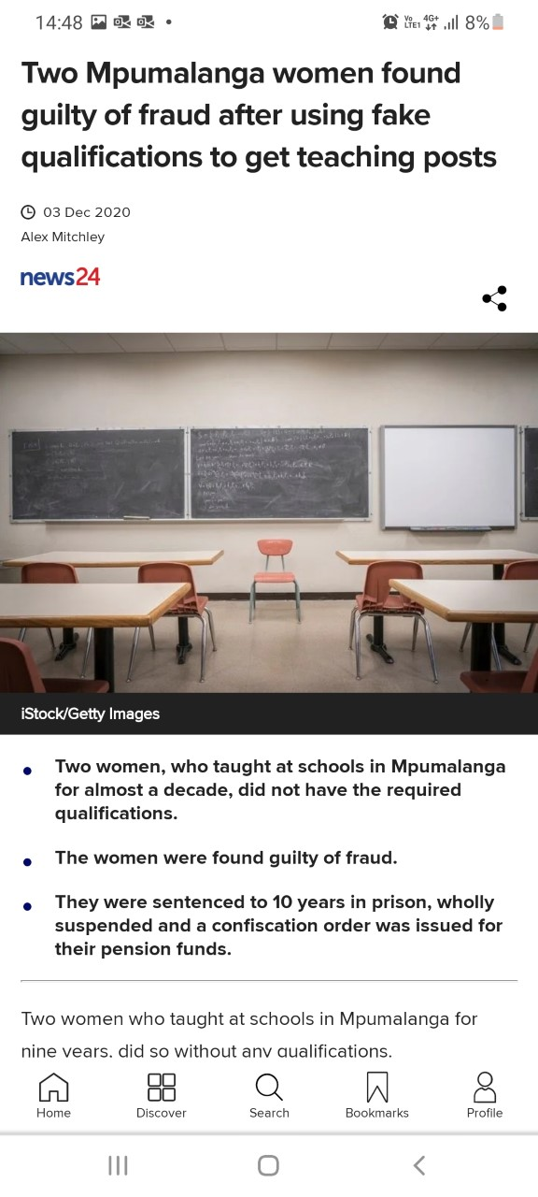
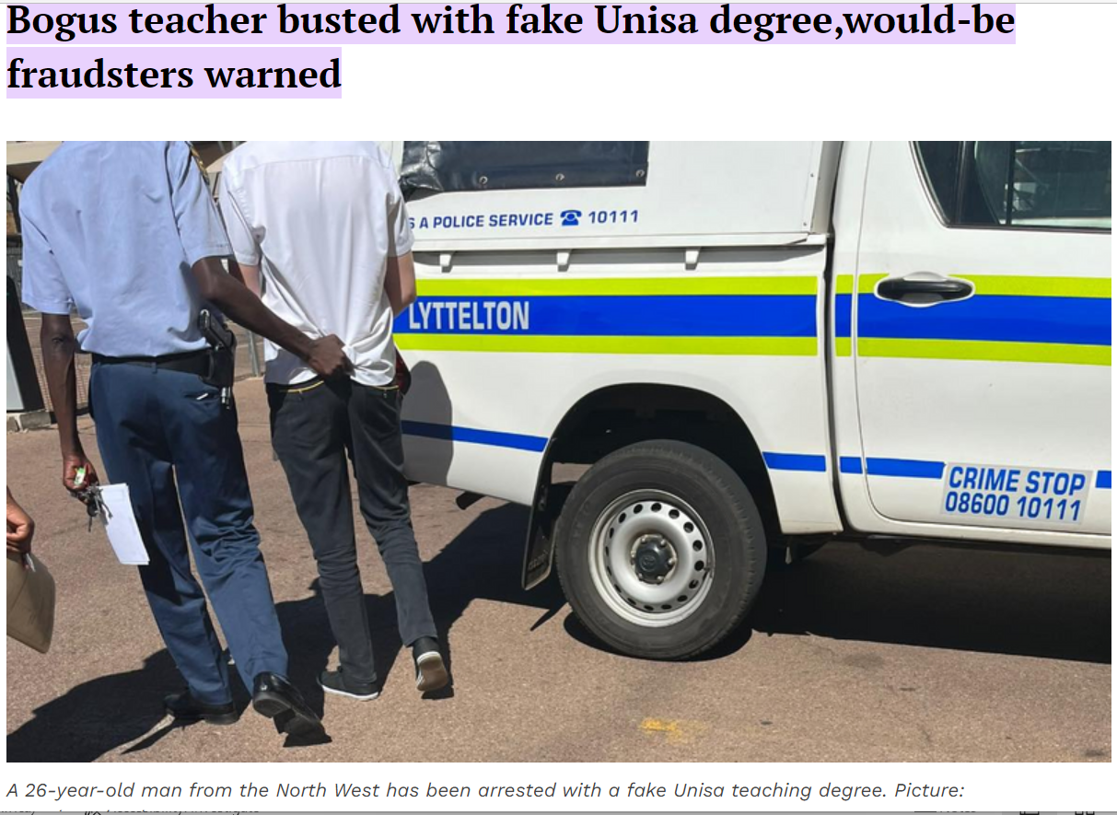

Slide 65
WHO IS ELIGIBLE TO REGISTER WITH SACE ?
Section 3 of the SACE Act: This Act applies to all educators appointed-
in terms of the Employment of Educators Act, 1998 (Act No.76 of 1998)school and office-based educators, including therapists
in terms of the South African Schools Act, 1996 (Act No. 84 of 1996, as amended);
at an independent school;
in terms of the Further Education and Training Act, 1998 (Act No. 98 of 1998 - FETC Act no.16 of 2006 as amended);
at a further education and training institution – TVET Colleges;
at an adult learning centre – CET Colleges.

Slide 66
ECD Function Shift from DSD to DBE – Presidential Proclamation, ECD Policy, Curriculum Matters and HRD Strategy Professionalisation of the Sector (Practitioners and Educators) CURRENT SACE REGISTRATION ECD LEVEL 4, 5, Diploma in Grade R Teaching, BED (FP)
Diploma in Grade R Teaching – Restrictive to Grade R
Educare – Not for employment
NQF Level 4 (120 credits Conditional Registration)
Proceed to NQF Level 5 (Special Category) OR
Proceed to BED Foundation Phase (Full Registration)

Slide 67
POST - SCHOOLING (Public and Independent)
TVET College
Lecturers
CET College
Lecturers
HEIs
Teacher Educators
Qualified as professional teachers
NATED Qualifications and Trades
Will be qualifying in line with the new TVET qualification framework
HEIs Teacher Educators Outside the Scope Currently – Need to bring them on board
Student Teachers – Not Mandatory / Done on an adhoc basis

Slide 68
REVISED REGISTRATION SCOPE
Fully Qualified Educators / Lecturers
Full Registration Status to Practice
Student Teachers
Provisional Registration Status for BEd and PGCE
The status should not be used for employment purposes
Special Category
Conditional Registration Status with some limitations to a subject / phase / school
Three Stream Model, Focus Schools (Sports, Maritime, Arts, Aviation, Hospitality, Agriculture, etc)
Academically Qualified and Professionally Unqualified practicing teachers MUST BE studying towards PGCE
Provisional Registration Status Renewable Annually up to a period of Three Years ONLY.

Slide 69
WHEN WE REGISTER, YOU AGREE TO MAINTAIN THE ETHICAL STANDRADS THROUGH THE CODE OF PROFESSIONAL ETHICS IN DOING SO, YOU ARE SIGNING A SOCIAL CONTRACT TO PROTECT CHILDREN WHO ARE IN OUR CARE BECAUSE THE CONSTITUTION DIRECTS US THAT THE INTERESTS OF THE CHILD ARE PAROMOUNT

Slide 70
Excluded From the SACE Scope
Teacher / Education Assistants
Sports Coaches
Extra-Curricula Trainers / Private Tutors
Food Handlers
After care Staff
Security Guards
Scholar Transport

Slide 71
SOME PROPOSALS – SACE REVIEW & REPOSITIONING
Registration of Student Teachers from year one
Three-year or five-year periodic renewal of the professional registration status
Exploring the need for paraprofessionals in the teaching profession – Teaching Assistants
One-year mandatory induction for the newly qualified teachers

Slide 72
SACE FEES
R200 – South African (Once-Off Registration Fee)
R400 – Foreign Nationals (Once-Off Registration Fee)
R50 – 00 Update from Provisional to Full Registration Status (Once-Off)
R16-50 Mandatory Monthly Membership Fee -Once Employed as Qualified Educator from 1st April 2022 (Reviewed periodically)

Slide 73
GROWING - AS AN EXPERIENCED ETHICAL AND TRUSTWORTHY TEACHER / LEADER (Continuing Professional Learning and Growth)

Slide 74
Continuing Professional Learning and Growth)- Mandatory Continuing Professional Development System

Slide 75
CHANGE IS THE ONLY CONSTANT IN LIFE PROGRESS IS VIEWED AS THE ABILITY TO ADAPT TO CHANGE

Slide 77
SECTION 7 OF THE SACE CODE OF PROFESSIONAL ETHICS – KEEP ABREAST WITH EDUCATIONAL DEVELOPMENTS RESPOSIBILITY TO DEVELOP AND SUPPORT FELLOW EDUCATORS

Slide 78
“What once worked, is now obsolete. Therefore, we need to rewire ourselves with for new ways of leading” (METACO Leadership Institute) “If you are not leading change then you are not leading anything. You are merely managing status quo” (METACO Leadership Institute) “Those who do not read and learn, should not lead” (Prof Tshilidzi Marwala)

Slide 80
Future –Fit
Future-Proof
Change-Fit
Digitally Fit & Savvy
Disruption is never comfortable, but regardless of whether positive or negative, it is a catalyst for change.
Learning for Tomorrow Today
Creating a Culture and Climate Conducive for Change and taking the Leadership Space and World of Work Into the Future

Slide 81
Section 5(b)
MANDATORY
FUNCTIONS
(aa) the minimum requirements for entry to all the levels of the profession;
(bb) the standards of programmes of pre-service and in-service educator education;
(cc) the requirements for promotion within the education system; and
(dd) educator professionalism;
Manage a system for continuing professional development of all educators in schools
Advice The Minister on the following:
Must promote, develop and maintain a professional image
must research and develop a professional development policy

Slide 82
PROFESSIONAL DEVELOPMENT
MANDATORY
must promote, develop and maintain a professional image;
must advise the Minister on matters relating to the education and training of educators. including but not limited to:
the minimum requirements for entry to all the levels of the profession;
the standards of programmes of pre-service and in-service educator
education:
the requirements for promotion within the education system;
educator professionalism;
must research and develop a professional development policy;
must manage a system for the promotion of continuing professional development for all educators in schools;
Teacher Professionalisation/ Professional Standards
CPTD Management System

Slide 83
PROFESSIONAL DEVELOPMENT
DISCRETIONARY FUNCTIONS
may develop resource materials to initiate and run, in consultation with an employer, training programmes, workshops, seminars and short courses that are designed to enhance the profession;
may compile, print and distribute a professional journal and other publications;
may establish a professional assistance facility for educators

Slide 84
PARTICIPATION IN THE CPTD MANAGEMNET SYSTEM ALSO SUPPORTING THE SUMMATIVE APPRAISAL DATA FROM THE QMS

Slide 85
ETHICAL STANDARDS

Slide 86
MAINTAINING ETHICAL STANDARDS DURING TEACHING PRACTICE AS A PROSPECTIVE EDUCATOR UPHOLDING ETHICAL STANDARDS AS A NEWLY QUALIFIED AND EXPERIENCED UPHOLDING ETHICAL STANDARDS AS AN EXPERIENCED EDUCATOR EDUCATOR

Slide 87
ETHICAL STANDARDS – SACE ACT
must compile, maintain and from time to time review a code of’ professional ethics for educators who are registered or provisionally registered with the council
must determine fair hearing procedure
subject to subparagraph (ii), may—
(aa) caution or reprimand;
(bb) impose a fine not exceeding one month’s salary; or
(cc) remove from the register for a specified period or indefinitely. or subject to specific conditions, the name of an educator found guilty of a breach of the code of professional ethics and
(iv) may suspend a sanction imposed under subparagraph (iii)(bb) or (cc) for a period and on conditions determined by the council

Slide 88
Legislative and Policy Environment
The RSA Constitution
SACE Act (Act no.31 of 2000)
SACE Code of Professional Ethics
Section 17 – Employment of Educators’ Act (Act no. of 1998)
ELRC Collective Agreement no. 3 of 2018
Department of Basic Education Protocol for Management and Reporting of Sexual Abuse
The Children’s Act
The Criminal Law (Sexual Offenses and Related Matters) Act
2020 – 2030 National Strategic Plan on Gender-Based Violence

Slide 89
FLOWING FROM THE SACE ACT – LEADING TO SACE BEING A QUASI COURT
Code of Professional Ethics Applicable 24/7, 365/366 days a year, In and out of the school environment
Educator’s Ethical Relationships With….
Educator and the Learner
Educator and the Parent
Educator and the Community
Educator and the Employer
Educator and the Colleagues
Educator and the Council
Educator and the Profession
WHAT IT MEANS TO BE AN ETHICAL SOUTH AFRICAN TEACHER
Professional and Peer-Based Accountability, Commitment, Responsibility, Judgement

Slide 90
Violation of the Professional Ethics - impact on children and other educators’ human rights
Fundamental right to protect children
Duty of Care and Institutional Betrayal
Unethical Through:
Professional Boundary Crossing or Transgression : Departure from usual professional practice that are not necessarily exploitative. Occasionally a boundary may be crossed with the intention of assisting a child or a colleague
It can also take place as part of slippery slope of moving from outside the usual practice to inappropriate practice that end up harming a child or a colleague.
Grooming the children
Professional Violation : Transgressions that harm the learner in some way. It undermines the educator-learner relationship and the respect that the community have in teachers.
This can cause profound psychological and health harm to learners and fellow colleagues.

Slide 91
Transgression / Violation of the Code of Professional Ethics Leads to…..

Slide 92
VIOLATION OF THE CODE RESULTS IN..
Physical Violence Abuse
Psychological Abuse
Sexual Violence
Abuse
Economic Abuse
Health
Verbal Abuse

Slide 93
COMMON AND SPECIFIC BREACHES REPORTED TO SACE ON EDUCATORS
Breaches
Late coming
Breaches
Breaches
Insubordination
Absenteeism
Physical Assault of a learner, parent or colleague
Fraudulent social grant
Corruption
Mismanagement of funds
Theft
Victimization
Humiliation of learner or colleague
Defamation
Intimidation
Verbal Abuse
Dishonesty
Exam fraud / irregularities
Fraudulent qualifications
Submitting falsified documents and qualifications
Undermining SMTs Authority
Undermining SGBs
Incitement to protest against leadership
Disruption of activities
Alcohol / Drug Abuse
Failing to comply with regulation
Improper / Vulgar Language
Other general misconduct
Pornography
Sexual relationship with a learner
sexual abuse of colleague / parent
sexual abuse of learners
sexual advances on a learner
Murder
Unfair treatment
Abuse of power
Illegal strikes
Racism
Discrimination
Unjustified prejudice
Poor performance
Failure to conduct required tasks
Unfairness to learners including expulsion and suspension of learners
Refusal to teach
Appointment of inappropriate or unqualified teachers
Negligence
Rape
Molestation
Indecent Assault
Corporal Punishment
Disrespect colleague
Threatening to kill
Fraudulent Reconstruction and Development Houses

Slide 94
MANDATORY REPORTING TO RELEVANT GOVERNMNET DEPARTMENTS / INSTITUTIONS ONCE SACTIONED BY SACE
Harshest Sanctioning by SACE –
Based on the guilty verdicts, removal of the perpetrators’ names (struck-off) from the register of educators in line with the SACE Act and SACE policy of mandatory sanctions.
Submit the names struck-off educators to the Provincial Education Departments for blocking against PERSAL
SACE further reports to the Provincial Education Department in line with Section 15 (2) of the Employment of Educators Act no 76 of 1998:
“If the name of an educator is struck off the register of educators kept by the South African Council for Educators, the educator shall, notwithstanding anything to the contrary contained in this Act, be deemed to have resigned with effect from the day following immediately after the day on which the educator's name was so struck off”

Slide 95
MANDATORY REPORTING TO RELEVANT GOVERNMNET DEPARTMENTS / INSTITUTIONS ONCE SACTIONED BY SACE ….
Submission of the struck-off names to the Department of Social Development for inclusion in the National Child Protection Register for them to be declared “NOT SUITABLE TO WORK WITH CHILDREN ANYWHERE IN THE COUNTRY”;
Reporting the perpetrators to the SAPS – for possible conviction and inclusion in the Department of Justice and Constitutional Development’s National Register of Sexual Offenders
Reporting to Department of Home Affairs (Immigration)
Reporting to the Commission for Gender Equality
Reporting to Human Rights Commission

Slide 96
Corporal Punishment UPDATE
Headlines in the Media
Oulawed, practice
Public interest groups
Sanctioning
High Court Review and Implications if the case is won
Children’s Act section – National Child Protection Register

Slide 97
PROFESSIONALISING THE TEACHING PROFESSION

Slide 98
PROFESSIONALISING THE TEACHING PROFESSION Enhancing the status and standing of the teaching profession and its internal quality across the teacher education and development continuum Because: Teaching is a Profession and NOT a semi-profession Teaching is not a free for all Teaching is NOT something that everyone can do Teaching should not be an after thought or last resort profession

Slide 99
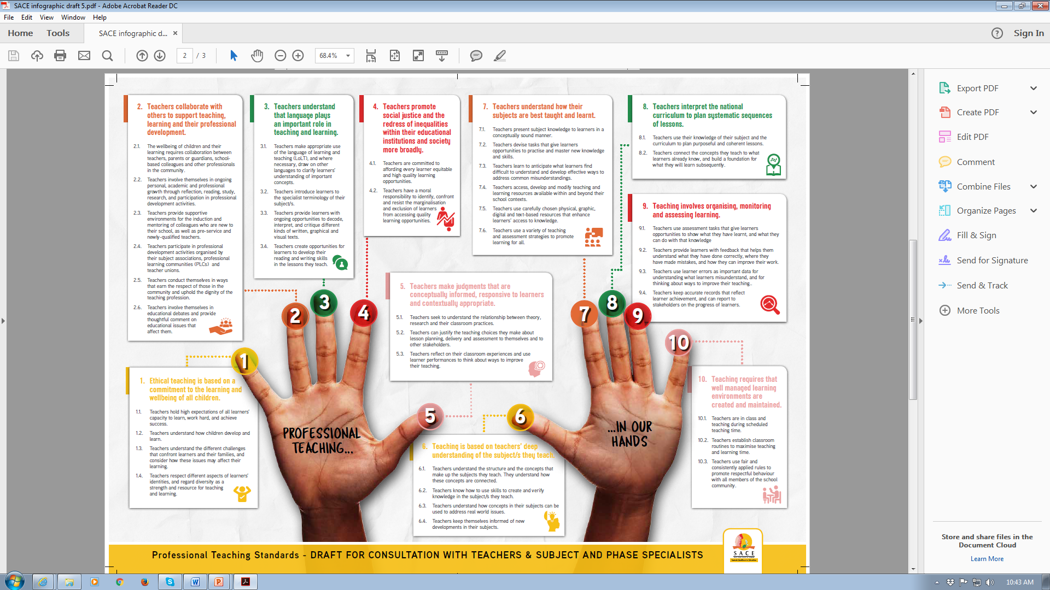
Professional Teaching Standards for South Africa www.sace.org.za

Slide 100
TEACHER SAFETY AND SECURITY IN SCHOOLS A Whole School Approach

Slide 102
Violation of Our Teachers’ Constitutional Rights, Dignity, Humanness
SA teachers not safe as pupils become aggressive
Pupil's vicious attack on Soweto teacher caught on video
Pupil abuse drives teacher out of school
A teacher has allegedly been stabbed to death by the learner he reprimanded for allegedly skipping a queue at school
More than 60 attacks on Cape teachers recorded thus far
School violence: 'Learning, teaching cannot be conducted in fear

Slide 103
PRINCIPAL MOERED A TEACHER

Slide 104
PRINCIPAL SHOT AT A SCHOOL IN MSINGA

Slide 106
PARENTS JOINING THE VIOLENCE FRAY AS WELL

Slide 107
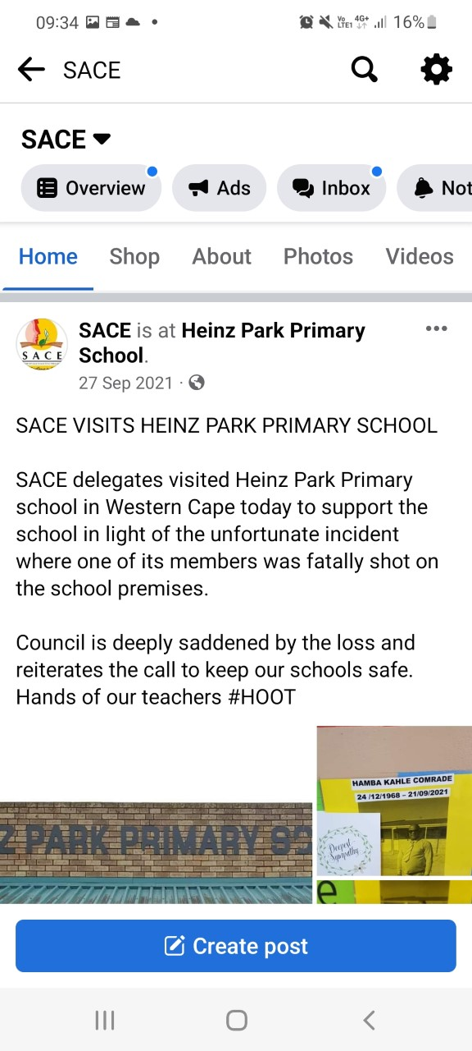
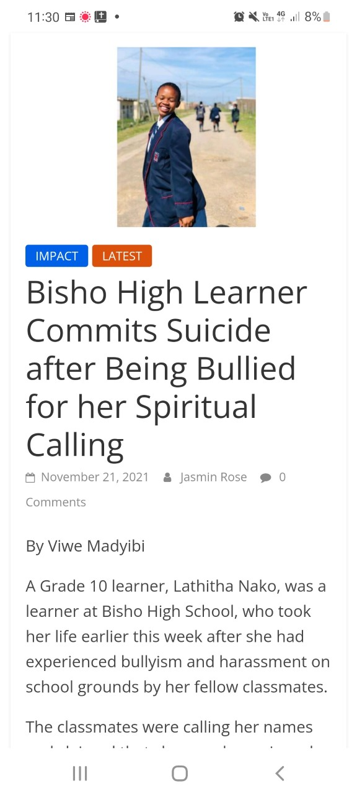

Slide 108
EDUCATOR MISCONDUCT CASES REPORTED TO SACE
Research on cases reported to SACE:
Trends analysis (2008 – 2012 and 2013 – 2017),
Trends analysis (2008 – 2012 and 2013 – 2017),
Factors that enhances sexual misdemeanour in schools
School-Based Violence
Physical Assault
Sexual Abuse
Verbal Abuse
Teacher-on-Learner
Teacher-on-Teacher
Learner-on-Teacher
Teacher-on-Parents
Parents-on-Teachers

Slide 109
Teachers’ Rights, Responsibilities and Safety Programme and Campaign, a necessary condition for effective process of Professionalising the Teaching Profession.
Launched in March 2019 Nationally and in four Provinces
Research Conducted, informed by literature and Teacher Focus Group Sessions in all the 9 provinces, data from commissions in the four provinces, and interviews
Research Report Released
Draft Teachers’ Rights, Responsibilities, and Safety Handbook Produced
2018/19 DELIVERABLES

Slide 110
Teachers’ Rights, Responsibilities and Safety Provincial Teacher and stakeholder Round Tables opportunity to finally shape the Handbook.
Launched the Handbook Nationally in 2020
Distributed the Handbook to all the Teachers Electronically
Mixed Mode Capacity Building and Support Programme (webinars, Workshops, online Programme, teacher workbooks, facilitators guide)
Heightening Advocacy, Education and Communication on Teachers’ Rights, Responsibilities and Safety
2020 - 2025 DELIVERABLES

Slide 111
Teachers Safety And Security In Schools: A Handbook
#HOOTS CAMPAIGN - HANDS OFF OUR TEACHERS AND STUDENT TEACHERS THEIR RIGHTS, DIGNITY AND LIVES MATTER
FOLLOWS A WHOLE-SCHOOL APPROACH
ACKNOWLEDGES THAT TEACHERS, STUDENT TEACHERS AND LEARNERS’ RIGHTS ARE HUMAN RIGHTS TOO
sace teachers safety and security handbook - Google Search
(Press Control +Click on the link to access the handbook)

Slide 112
PURPOSE OF THE HANDBOOK
As a source of reference and guidance, the Teachers’ Safety and Security in South African Schools
Provide educators with guidance on how educators should protect themselves in violent situations they may confront in the school environment.
Likewise, the handbook assists educators to know what action to take to decrease the risk of violence against every member of the school community. In
Provides educators with an opportunity to create a safe school environment and perform their daily roles and responsibilities without fear and intimidation from others within the school community.

Slide 113
Summary of Handbook Content
Resourceful handbook is divided into five steps underpinned by a whole school approach,
Includes scenarios that might be applicable to an everyday situation in a school environment.
The five steps include:
understanding violence;
understanding roles and responsibilities;
understanding the risks of violence in your school;
taking action in potentially violent situations; and
evaluating, reflecting and improving processes and actions

Slide 114
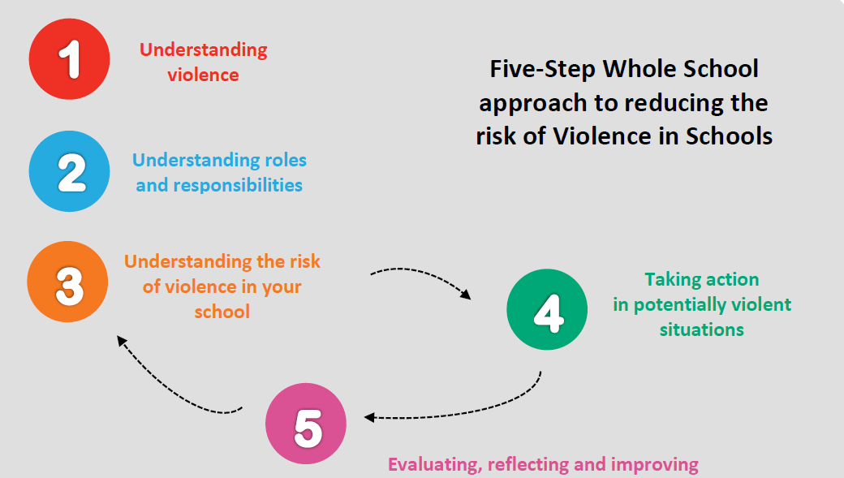
The five distinct steps to follow

Slide 117
ONLINE TEACHER SAFETY AND SECURITY SELF-DEVELOPMENT PROGRAMME

Slide 119
SACE VIRTUAL LIBRARY FOR EDUCATORS AND STAKEHOLDERS

Slide 120
Promoting a Reading Teaching Profession
As part of supporting the Presidential and Ministerial priority on reading, SACE launched a Virtual Library to promote a reading profession.
The Virtual library has over 50 000 free titles available for teachers and SACE stakeholders to access immediately, including the CAPS related ones.

Slide 121
ACCESSING THE SACE VIRTUAL LIBRARY
Getting started https://sace.snapplify.com/invitation/code/sace2021

Slide 122
Inclusivity and Equality based on sexual orientation and Identity

Slide 123
THE PLIGHT AND RIGHTS OF THE LGBTQI+ COMMUNITY IN OUR SCHOOLS MATTER TOO

Slide 126
NO ONE IS THE SAME, BUT EVERYONE IS EQUAL IN OUR SCHOOLS AND THE PROFESSION

Slide 127
LITTLE OR NO REPORTING / NORMALISING THE SITUATION
Promotion of Equality and Prevention of Unfair Discrimination Act, 2000 (PEPUDA or the Equality Act, Act No. 4 of 2000) is a comprehensive South African anti-discrimination law. https://www.gov.za/sites/default/files/gcis_document/201409/a4-001.pdf
It prohibits unfair discrimination by the government and by private organisations and individuals and
Forbids hate speech and harassment.
It lists race, gender, sex, pregnancy, family responsibility or status, marital status, ethnic or social origin, HIV/AIDS status, colour, sexual orientation, age, disability, religion, conscience, belief, culture, language and birth as prohibited grounds for discrimination.
Protection of the Teaching Profession through:
Reporting to SACE, violation of the Code of Professional Ethics
Equality Courts - hear complaints of discrimination, hate speech and harassment.
Chapter 9 Institutions: Commission on Gender Equality; South African Human Rights

Slide 129
Be the Change that you want see in your future school, staff room, classroom, circuit, CMC, district, province, community and amongst your colleagues
Ella Mokgalane
083 380 9879
ella.mokgalane@sace.org.za

