Slide 1
JOSEPH SAKU SECONDARY PRESENTER: MR MOHITLHI “Teacher Agency Autonomy and leadership” 20/04/2023 mohitlhia@gmail.com

Slide 2
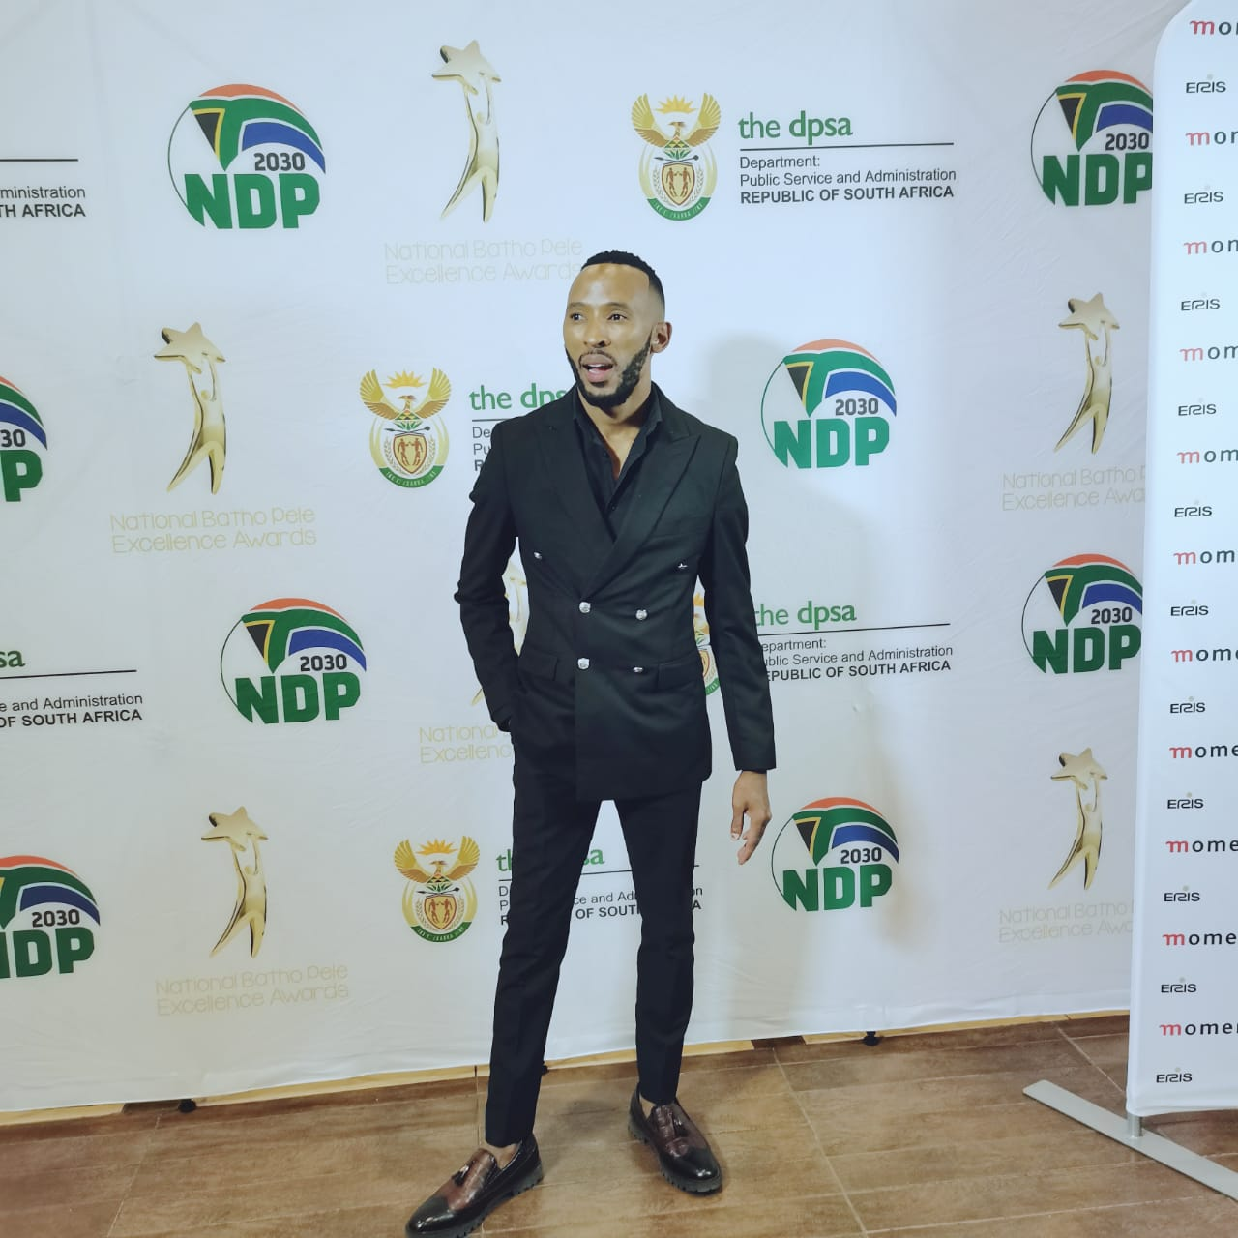
Mr Mohitlhi “The ultimate Dr Mohitlhi”
“Ngwana sejo o a tlhakanelwa”
Notes:
2

Slide 3
OUTLINE OF THE PRESENTATION
PERSONAL VISION AND MISSION
TEACHER AUTONOMY
TEACHER LEADERSHIP
CONCLUSION

Slide 4
PERSONAL VISION AND MISSION
VISION
Mission
values
To develop EACH child to ACHIEVE his or her FULL potential.
Fostering responsible attitude
Fostering Loyalty
Fostering Self discipline
Fostering Self control
Fostering Good manners
Inculcate positive interaction with the community
Protect and promote the right of every learner to :
Quality
Equitable
Culture based and complete basic education

Slide 5
TEACHER AUTONOMY
Generally perceived as a teacher’s competence to develop as a self-determined, socially responsible and critically aware participant in and beyond educational environments (Reich, 2002:46).
Teachers’ autonomy is also described as a capacity to take charge of, take responsibility for, or control learning, of all these definitions and ideas of autonomy.

Slide 6
Five categories of teacher autonomy

Slide 7
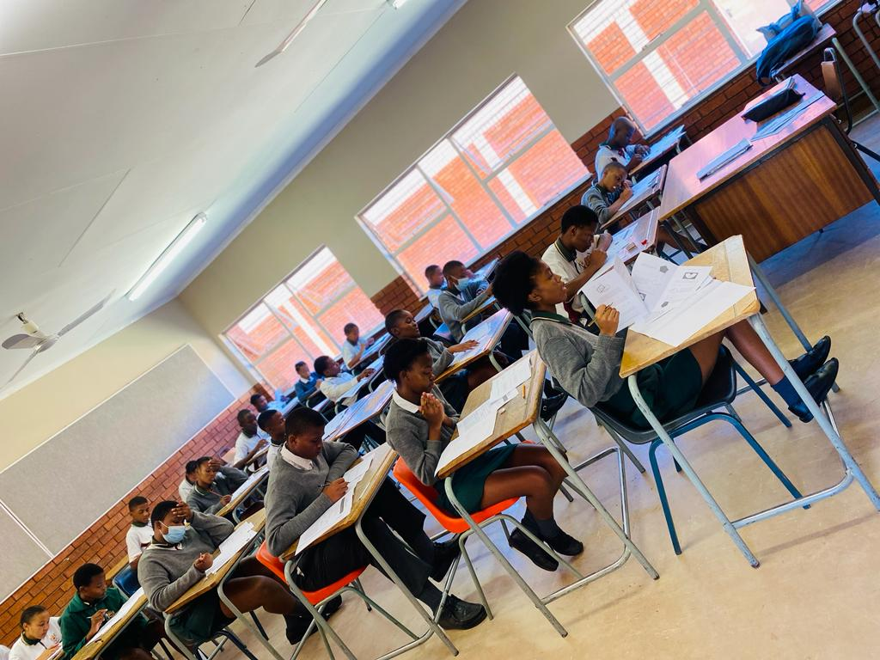
1 + 4 LEADER (2015 – 2017) LESSON STUDIES (2015 – 2017) ALGEBRA MARATHON (2021 – ONGOING) BURSARIES

Slide 8
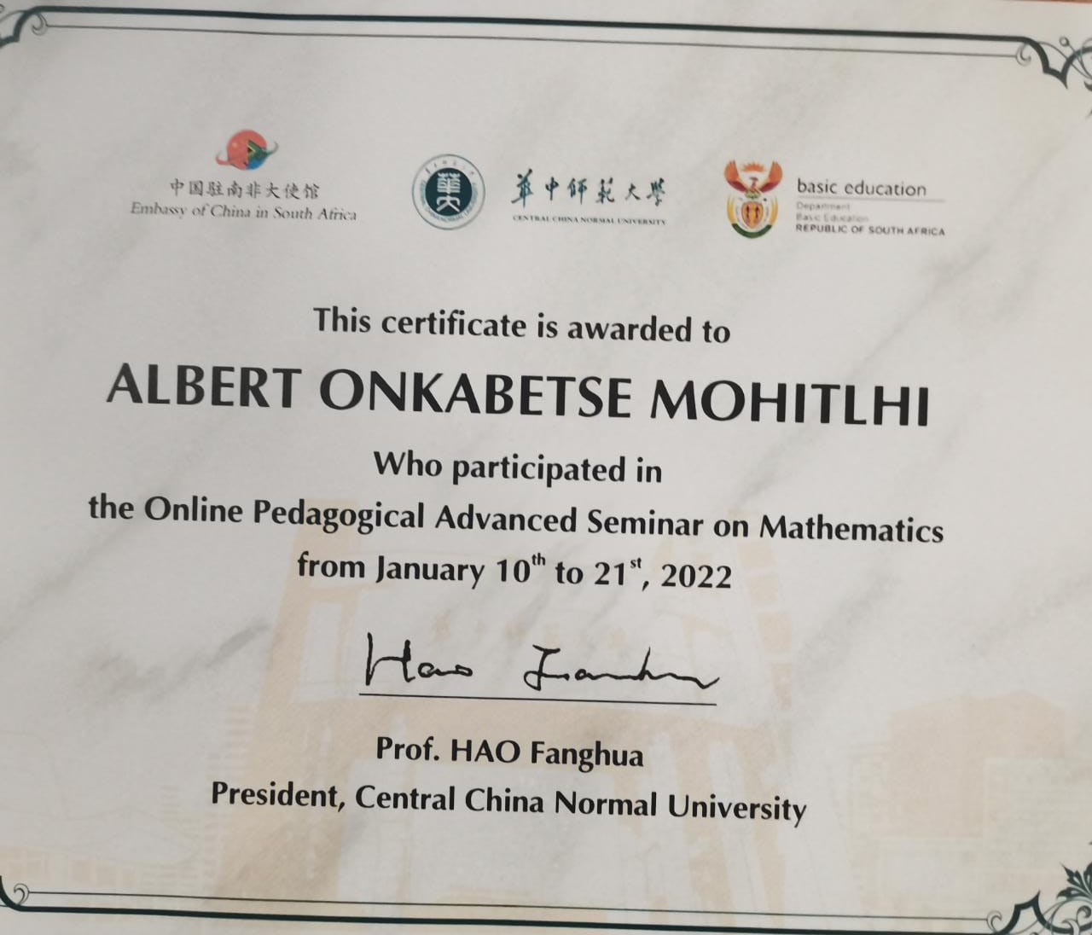
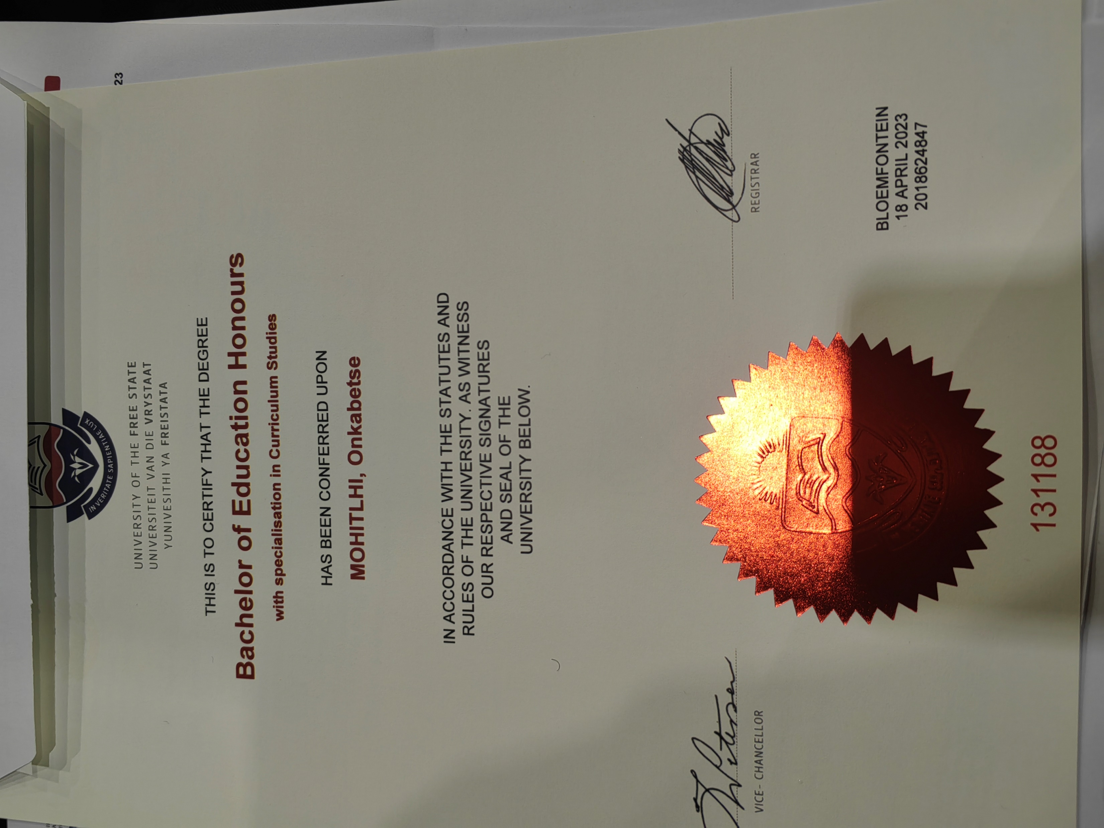
INTERACTION with learners LESSON STUDIES (2015 – 2017) ALGEBRA MARATHON (2021 – ONGOING) BURSARIES

Slide 9
Self - evaluation Learner evaluation QMS

Slide 10
SCHOOL A - MODISAKOMA SCHOOL B - TSELAATHUTO SCHOOL C – JOSEPH SAKU PPM VS CURRICULUM MATHEMATICS ENROLMENT

Slide 11
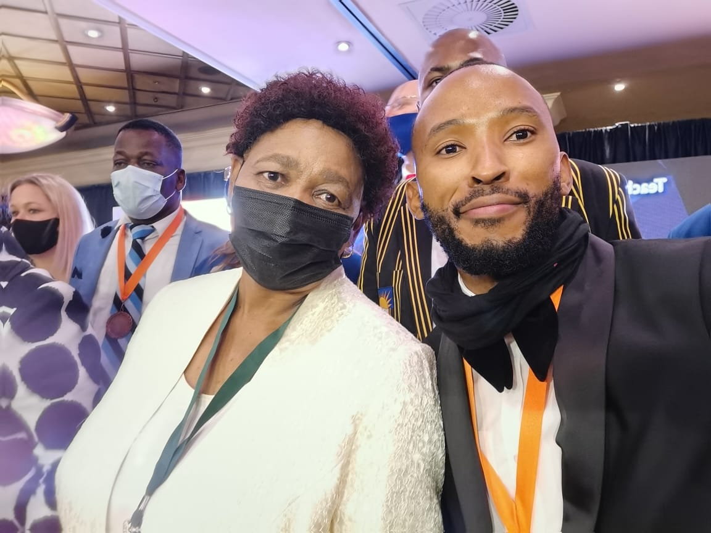
NTA WINNER 2021 BATHO PELE AWARDS 2022

Slide 12
What Teacher autonomy is not?
Teacher autonomy is not isolation
Teacher autonomy is not a static entity that some people posses and others do not.
Teacher autonomy cannot be interpreted as additional responsibilities given to the teacher

Slide 13
TEACHER LEADERSHIP
Teacher leadership is really a collective effort that empowers teachers to make positive contributions to the school community (Greenlee, 2007:73).
These teacher leaders possess a set of skills that not only allows them to be effective in the classroom but also permits them to exert influence beyond their classroom.

Slide 15
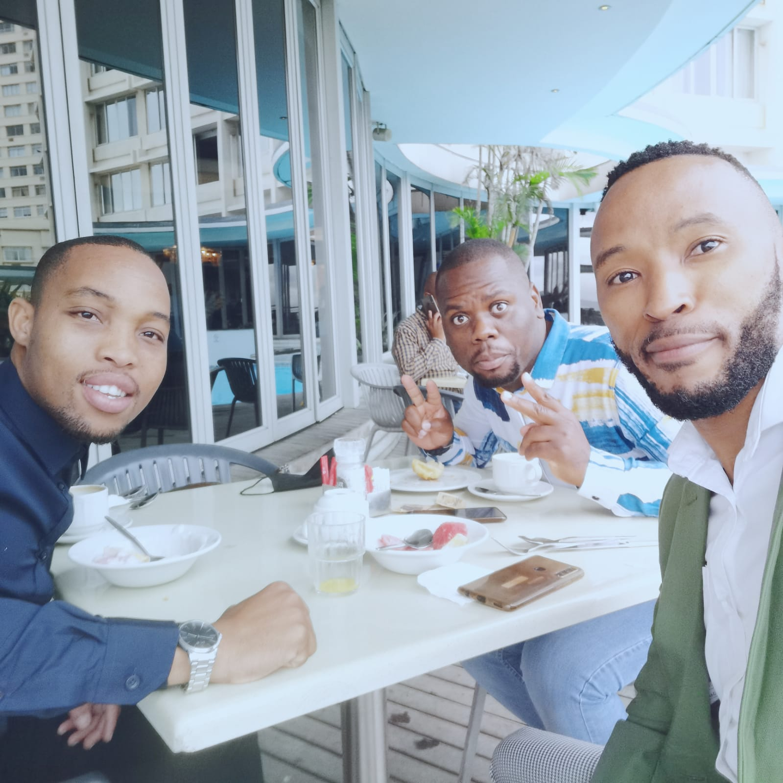
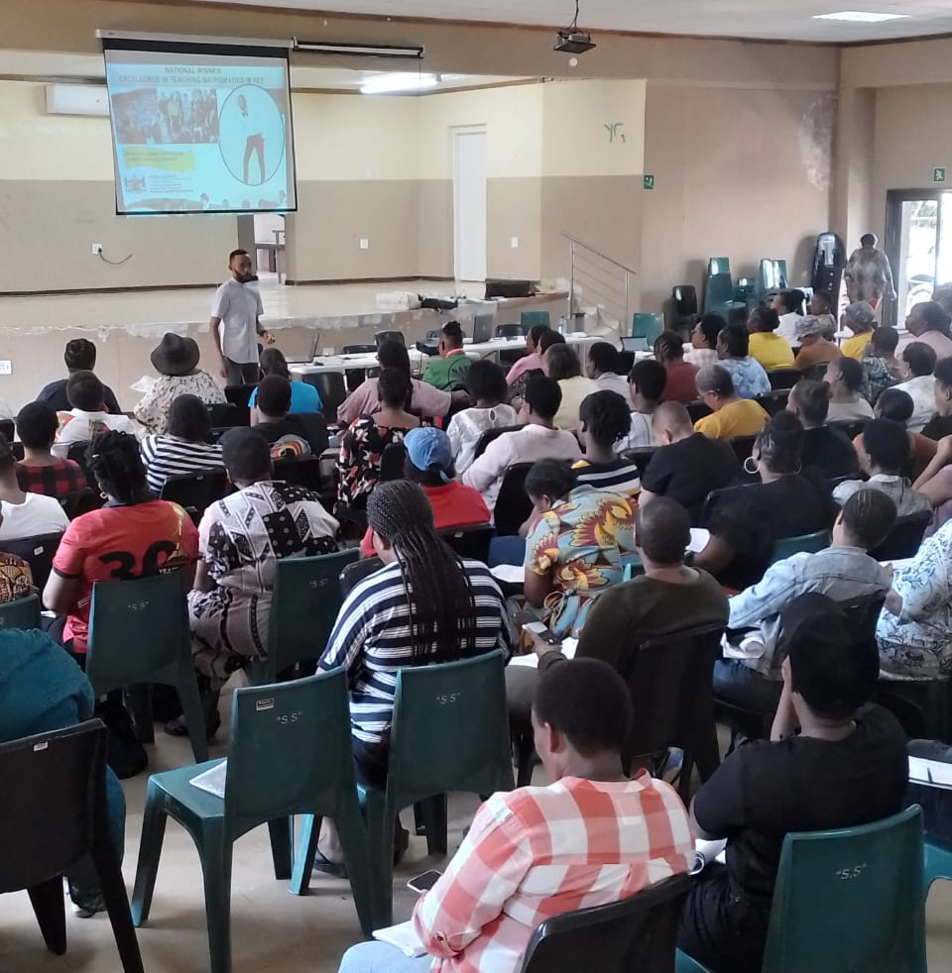
1. EXPERTS - TRAIT MATHEMATICS INDABA PREPARATION WEEK FOUNDATION PHASE

Slide 16
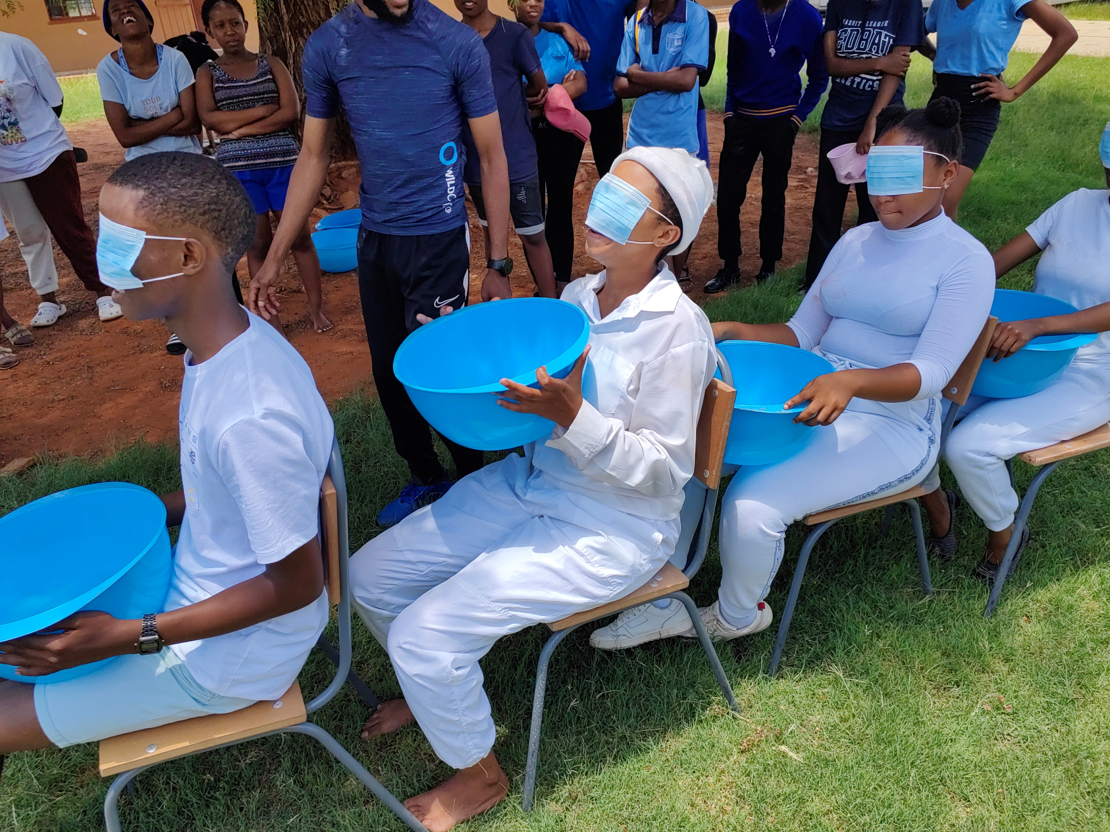
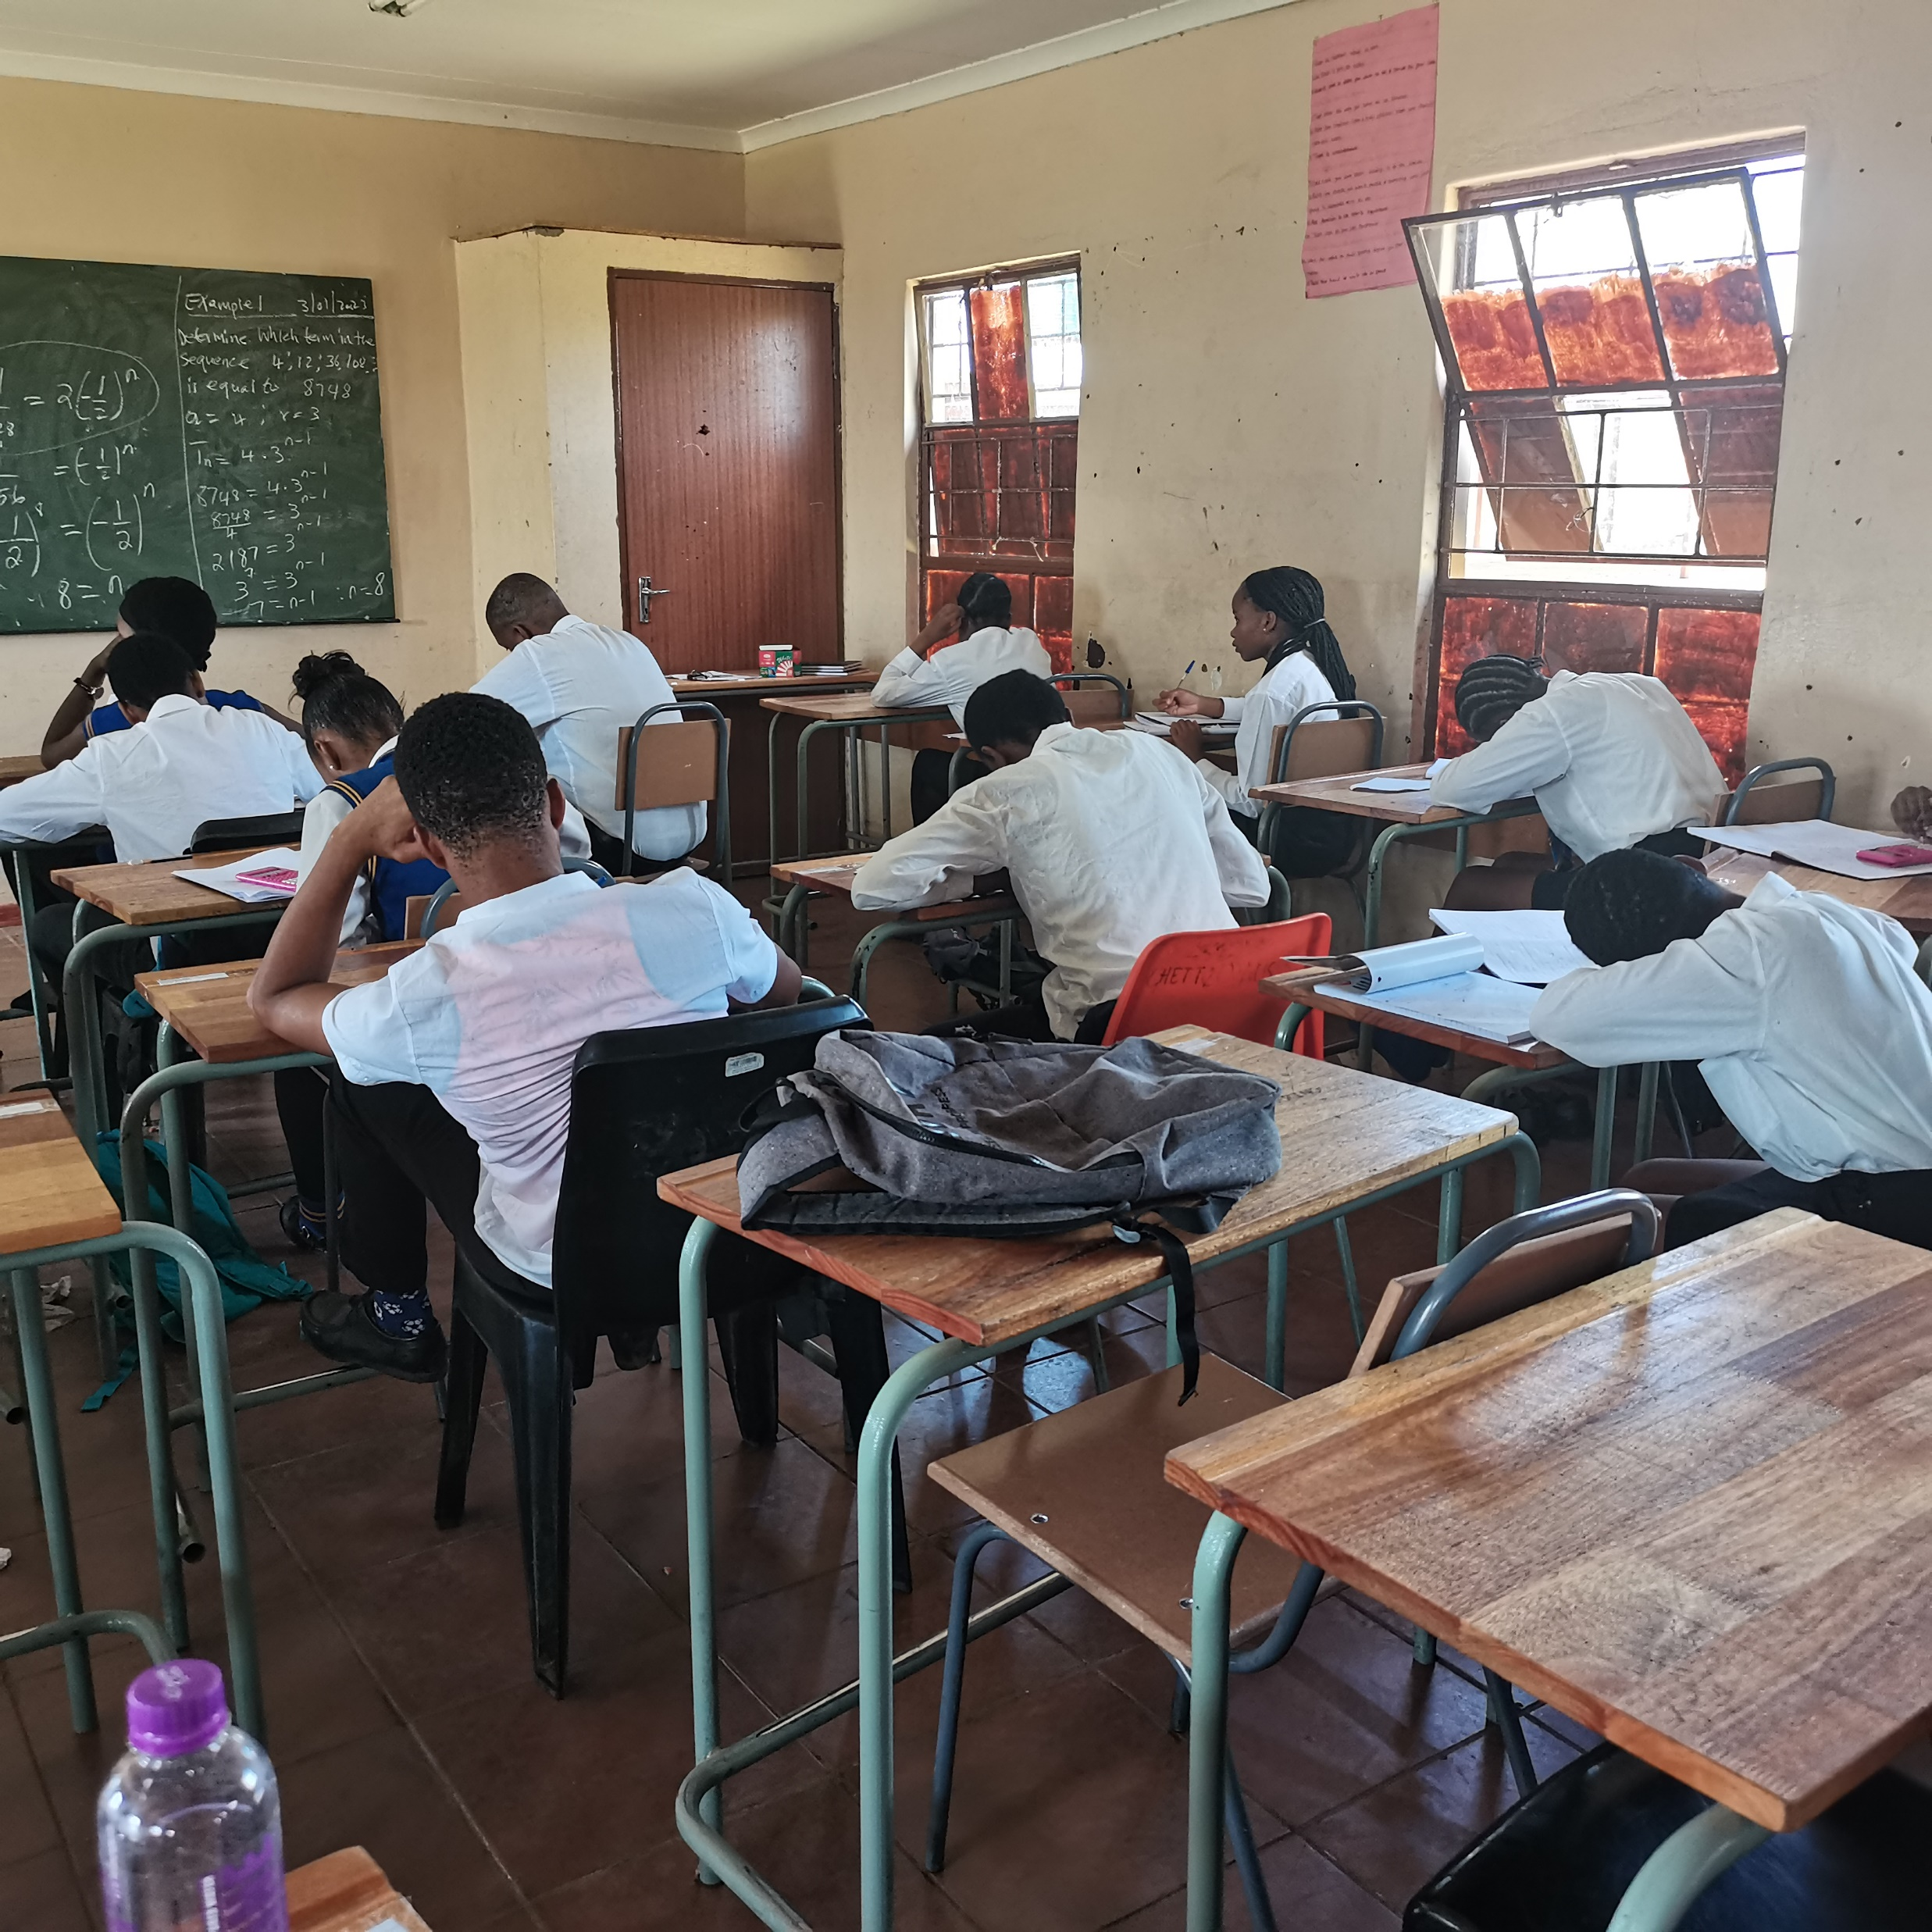
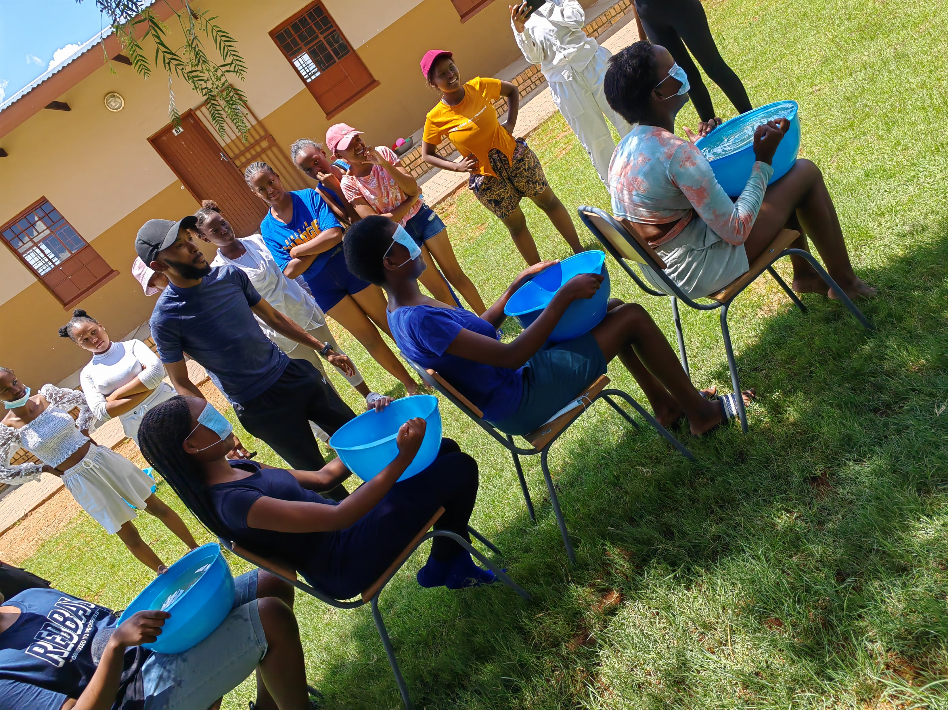
2. EXCEPTIONAL COMMUNICATORS

Slide 17
3. CHANGE AGENTS CURRICULUM DAY DHs empowerment TEAM BUILDING School culture

Slide 18
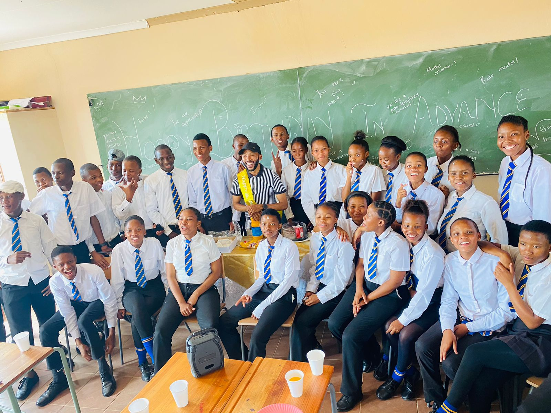
4. Inspirational Leaders CLASSROOM - SCHOOL COMMUNITY - DISTRICT PROVINCE – NATIONAL

Slide 19
INNOVATION AFRICA 2022 - ZAMBIA

Slide 20
DPSA

Slide 21
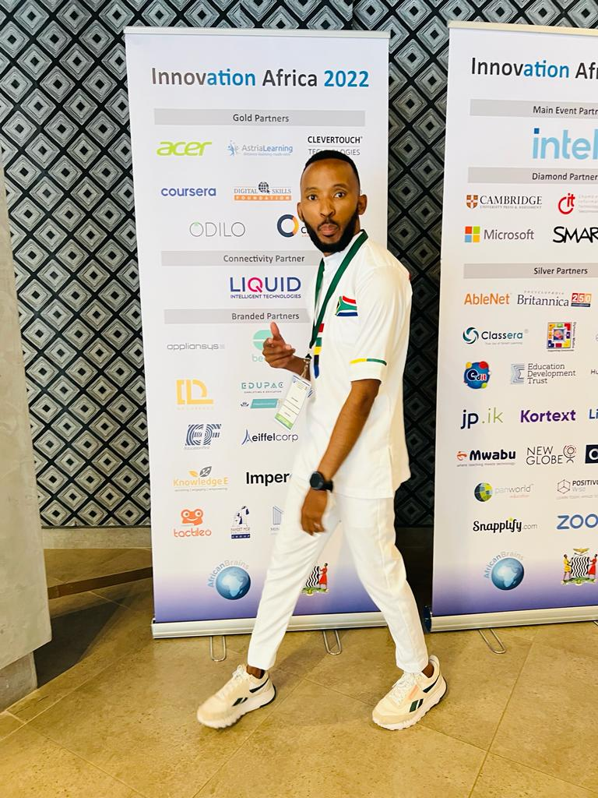
“In pursuit of excellence”

Slide 22
CONCLUSION
Impact nations, Influence nations and inspire them.
Leadership is results, talk is cheap but taking the first step is key.
Failure is a feedback not a full stop.
Excellence is a lifestyle. Live it.
Life is a celebration

Slide 23
LIFE IS A CELEBRATION THANK YOU
“Ngwana sejo o a tlhakanelwa”

