Slide 1
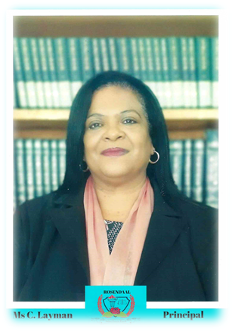
MANAGEMENT IN SCHOOL LEADERSHIP
(HAPPY WOMEN’S month TO ALL OUR WOMEN)

Slide 2
What does it mean to be a women?
STRONG SENSE OF IDENTITY
NATURAL ABILITY TO UPLIFT PEOPLE
COURAGES
THE ABILITY TO BE GREATFUL; SERVANT LEADERSHIP OPEN TO GROWTH

Slide 3
A FOCUS ON: WOMEN IN LEADERSHIP
Women in leadership is a driving force for positive change.
As we know women naturally gravitate towards leadership qualities that are more people orientated: collaboration, fostering, growth and the ability to share power and information and multitasking.
Additionally, we have acute interpersonal skills – working together in order to meet the goal.

Slide 4
STATISTICS OF WOMEN IN LEADERSHIP
THEN: 2019
NOW: 2021/2022
Working age population – 37.1 million
Females in senior management positions – 41.6%
Female CEO’S and managing directors – 15%
40 million (2021)
43.8% (2021)
26% (2021)

Slide 5
Top 10 FEMALE CEO’S LEADING SOUTH AFRICA’S BIGGEST BUSINESSES
1) Natascha Viljoen – CEO of Anglo American
2) Nompumelelo Zikalala – CEO of Kumba Iron Ore
3) Mpumi Madia – CEO of Bidvest Group
4) Bertina Engelbrecht – CEO of Clicks group
5) Dr Nombasa Tsengwa – CEO of Exxaro Resources
6) Albertinah Kekana – CEO of Royal Bafokeng Holdings
7) Jane Karuku – CEO and group MD of Eastern Breweries
8) Ntombi Felicia Msiza – CEO of Raubex group
9) Nneka Onyeali-ikpe – CEO and Mdof Fidelity bank
10) Zanele Matlala – CEO of Merafe Resources

Slide 6
PRINCIPLES OF WOMEN EMPOWERMENT:
Establish high level corporate leadership for gender equality
Promoting the Equity profile of staff at all levels. Roosendaal HS has 55% women representation in the school Management team.
Treat all women and men fairly at work and respect and support human rights and non discrimination
Ensure health and safety of women workers
Promote education, training and professional development for women
Implement strategies that empower women
Promote equality through community initiatives and advocacy
Measure and publicly report on progress to achieve gender equality

Slide 7
ROSENDAAL HIGH SCHOOL FEMALE LEADERSHIP

Slide 8
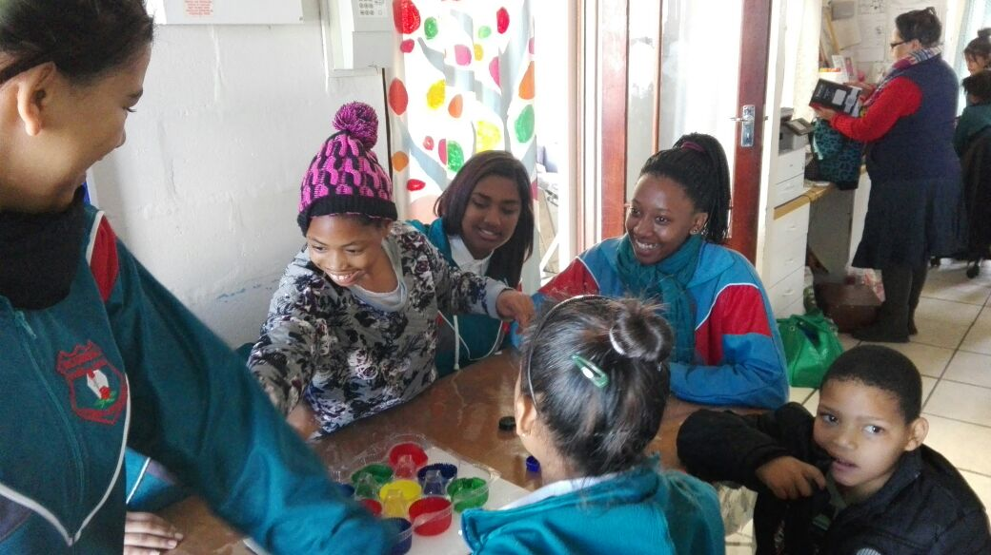
DRIVING OF POSITIVE CHANGE

Slide 9
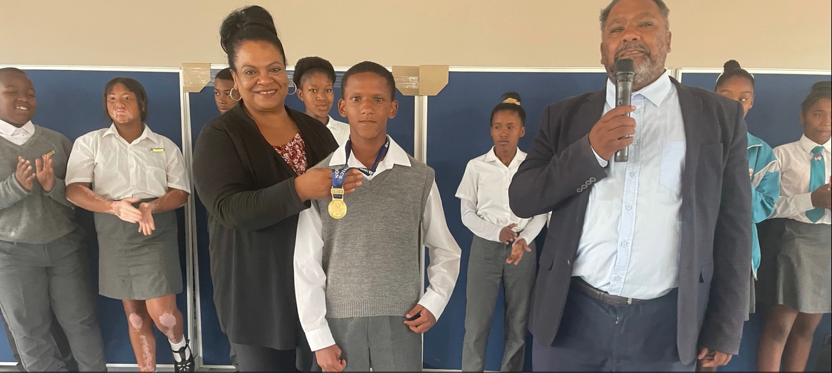
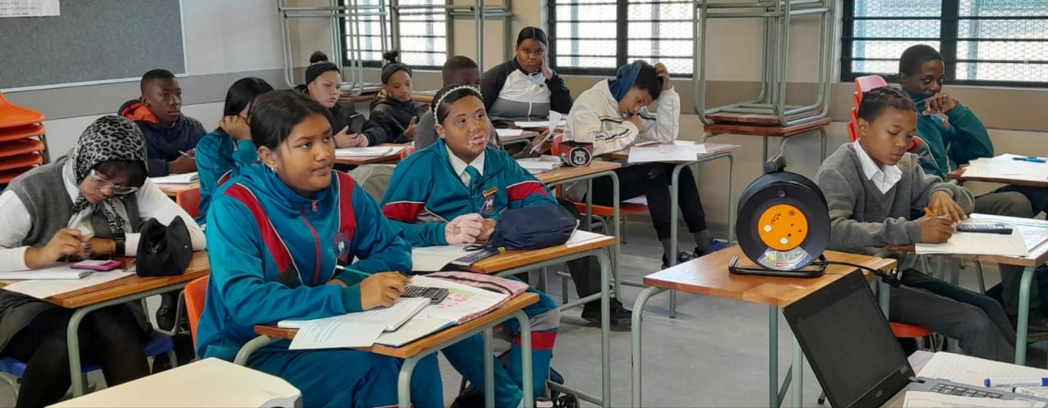
ACADEMIC EXCELLENCE

Slide 10
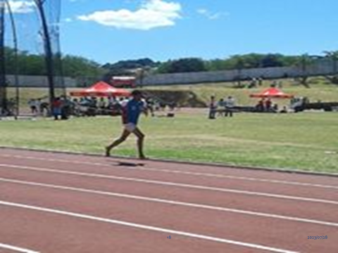
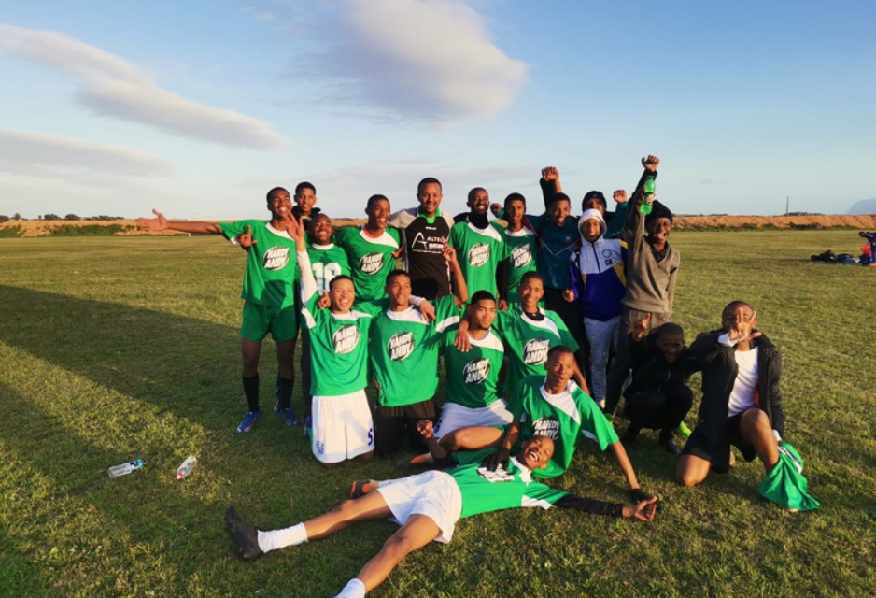
SPORT CLUBS

Slide 11
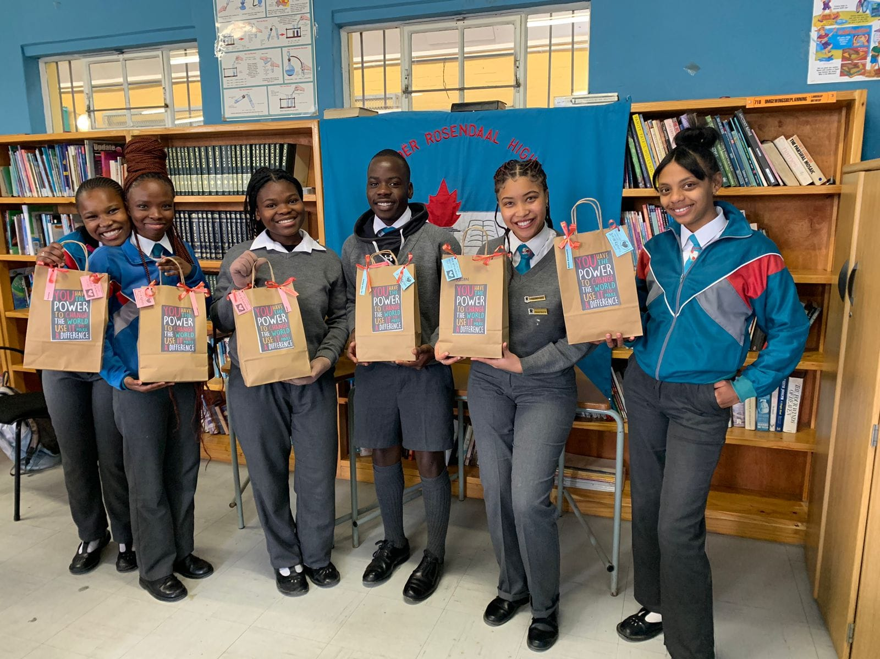
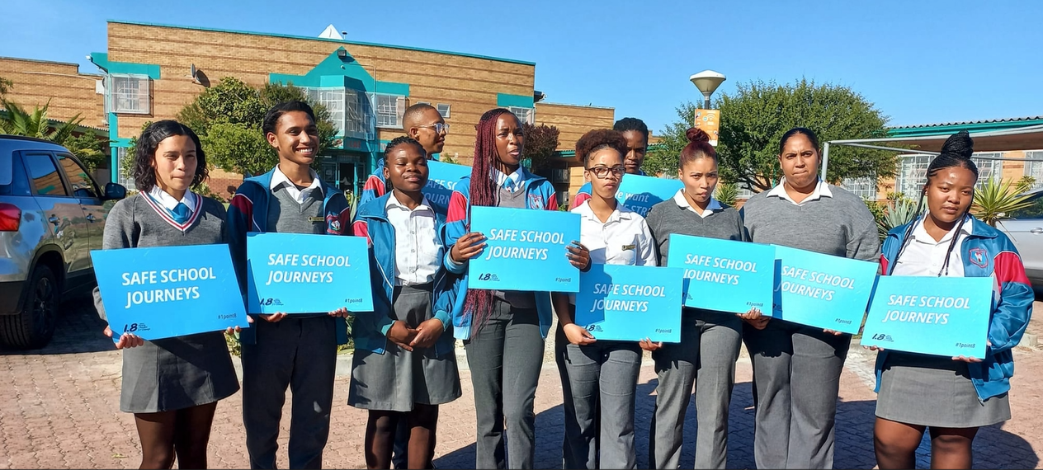
HUBS ACTIVITIES

Slide 12
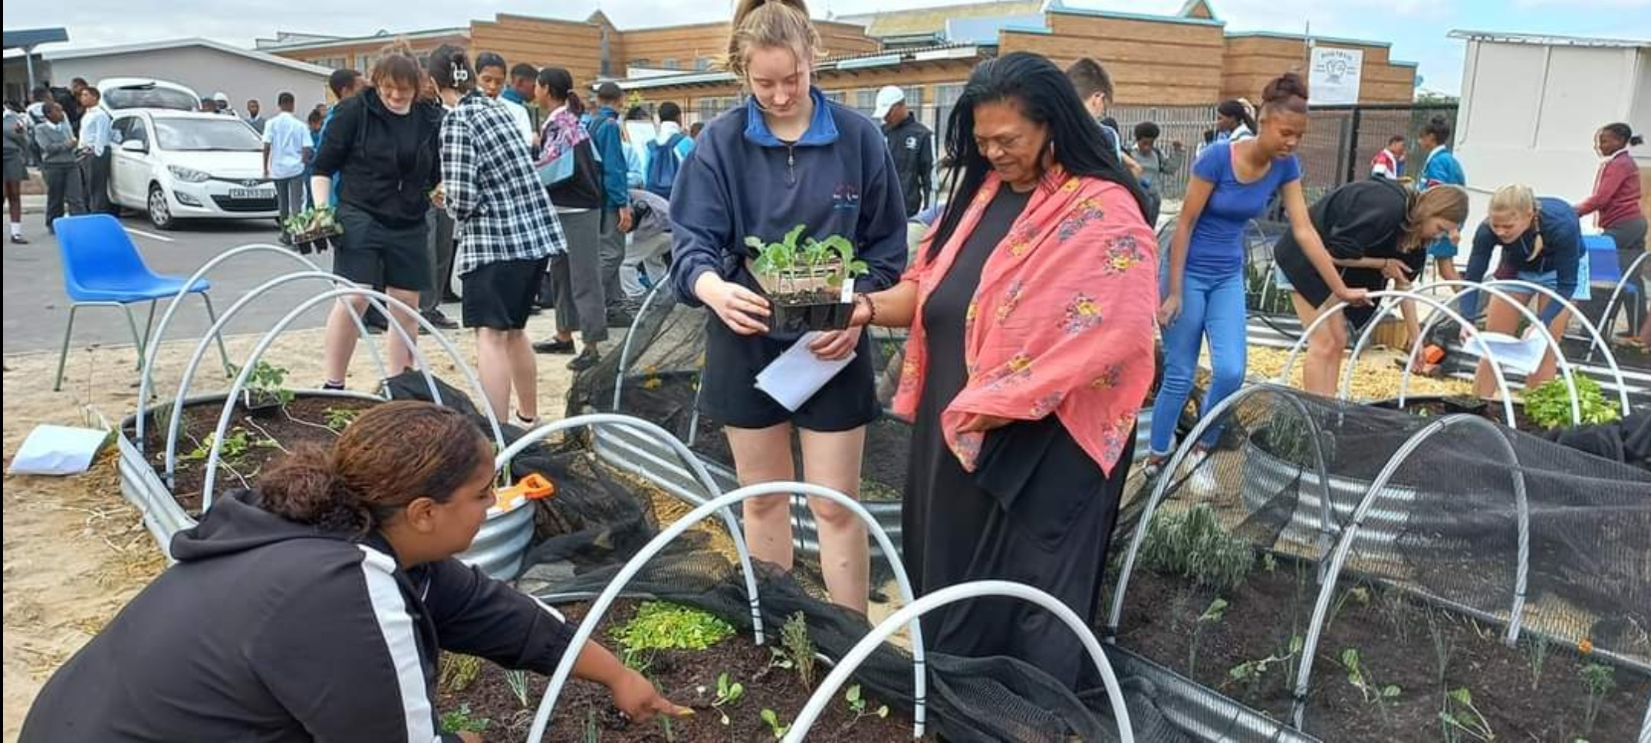
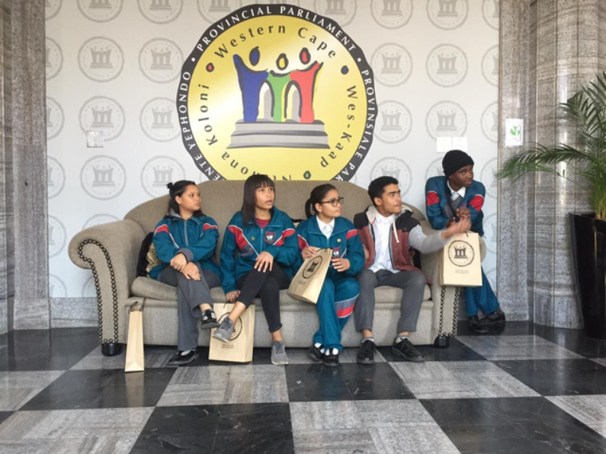
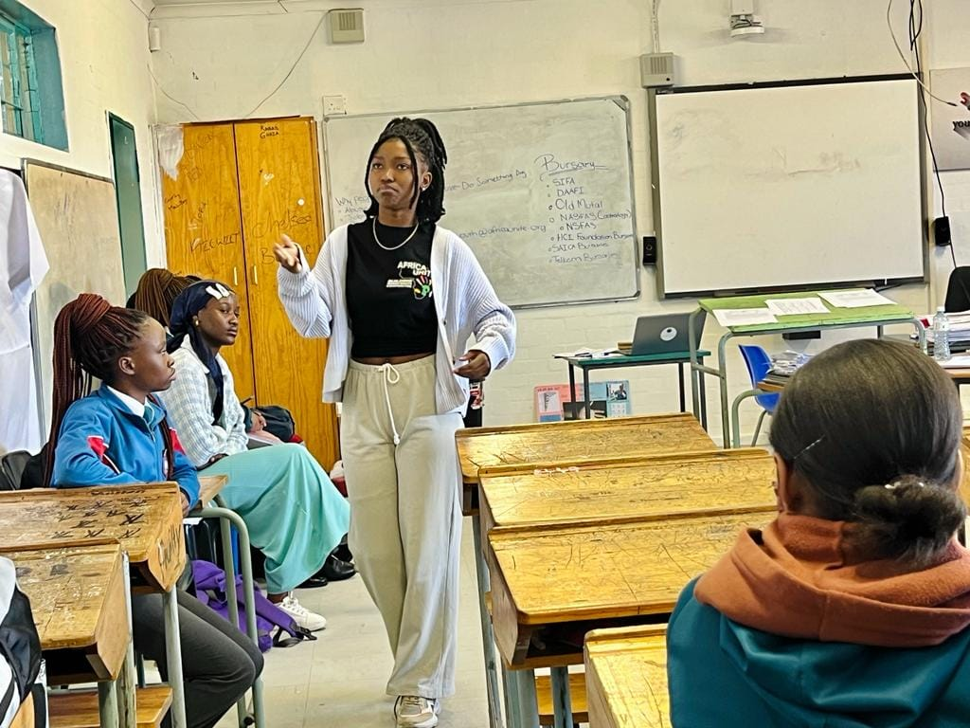
ARTS HUB
ENVIRONMENTAL HUB
RCL HUB
AU HUB
GPA HUB

Slide 14
THANK YOU !

