Slide 1

SACE TEACHERS CONFERENCE
CONTINUING PROFESSIONAL TEACHER DEVELOPMENT
MR T E RABOTAPI
21 APRIL 2023

Slide 2
CONTENTS
Background
Ministerial Committee on Teacher Education
Framework overview
Synopsis from Research Reports
Skills Development Expenditure Trends
What is the problem
Trends in E-learning
What needs to be done
Teacher Professionalization
Opportunities
Recommendations

Slide 3
BACKGROUND

Slide 4
MINISTERIAL COMMITTEE ON TEACHER EDUCATION IN SA
Mandated to:
Develop a National Framework for Teacher Education in SA;
to chart a long-term vision of a co-ordinated and coherent system of initial and continuing professional education of teachers
To focus on the systemic rôle that teacher education has in the overall transformation of education.

Slide 5
MCTE CONT….
RECOMMENDATIONS ON CPTD:
Recommendation B14
Retire the word 'qualified' (and its cognates) from use, and request the SACE to establish a new category of Registration: 'Licensed Teacher'.
Recommendation C16
Support the development of a Continuing Professional Teacher Development system by encouraging, resourcing and empowering the SACE to manage such a system.
Recommendation C17
Authorize the SACE to fulfil its mandate for the professional development of educators by establishing a CPTD system, which will endorse professional development activities and allocate Professional Development Points to them,
keep a register of endorsed PD activities and maintain a record of PD Points earned by Registered Educators.
Recommendation C18
Require all Licensed Teachers to earn a specified number of PD points, in three-year cycles, as a condition for maintaining their License

Slide 6
TEACHER DEVELOPMENT SUMMIT:2009
WHAT THE SUMMIT SOUGHT TO ADDRESS:
Poor capacity of the system to respond to TD needs;
Poor quality of TD programmes
Delivery of TD programmes that was uncoordinated, without proper institutional mechanisms;
Programmes that were not needs based and without impact in the classroom;
Unstructured funding mechanisms
Poor systems for needs identification

Slide 7
OVERVIEW
Integrated Strategic Planning Framework for Teacher Education and Development
OUTPUT 1
Individual and systemic TD needs are identified and addressed
OUTPUT 2
Increased numbers of high achievers are attracted into teaching
OUTPUT 3
Teacher support is enhanced at a local level
OUTPUT 4
An expanded and accesible formal teacher education system is established
ENABLERS
Collaboration
Time
Coodination
Funding

Slide 8
ACTION PLAN TO 2019 TOWARDS SCHOOLING 2030
Goal 16: Teacher capacity and professionalism
Improve the professionalism, teaching skills, subject knowledge and computer literacy of teachers throughout their entire careers.

Slide 9
SYNOPSIS FROM RESEARCH REPORTS

Slide 10
RESEARCH ON TEACHERS SPEAK:2019

Slide 11
RESEARCH ON TEACHERS SPEAK:2019

Slide 12
RESEARCH ON TEACHERS SPEAK:2019

Slide 13
RESEARCH ON TEACHERS SPEAK:2019

Slide 14
RESEARCH ON TEACHERS SPEAK:2019

Slide 15
RESEARCH ON TEACHERS SPEAK:2019

Slide 16
RESEARCH ON TEACHERS SPEAK:2019

Slide 17
RESEARCH ON TEACHERS SPEAK:2019

Slide 18
DPME RAPID RESEARCH
Figure 2: Participation Rate by Programme Type – Malaysia
Source: 2018 TALIS Results (OECD, 2019)

Slide 19
DPME RAPID RESEARCH
Figure 3: Participation Rate by Programme Type – Finland
Source: 2018 TALIS Results (OECD, 2019)

Slide 20
DPME RAPID RESEARCH
Figure 4: Participation Rate by Programme Type – Korogwe District Council (Tanzania)
)
Source: 2018 TALIS Results (OECD, 2019)

Slide 21
SKILLS DEVELOPMENT
EXPENDITURE TRENDS
2019-2022

Slide 22
SKILLS BUDGET ACROSS PEDs
(70% of 1%)
Province | 2019-20 | 2020-21 | 2021-22 | 2022-23
Eastern Cape | R203 991 053 | R 215 562 466 | R 199 601 220 | R207 959 227
Free State | R83 460 293 | R 83 690 383 | R 83 556 886 | R89 072 396
Gauteng | R256 284 609 | R 267 401 141 | R 273 347 949 | R296 006 312
KwaZulu-Natal | R317 865 527 | R 323 356 523 | R 309 021 097 | R309 021 097
Limpopo | R182 415 933 | R 184 256 450 | R 174 407 933 | R188 469 652
Mpumalanga | R121 921 436 | R 123 904 599 | R 130 086 236 | R130 485 334
North West | R94 360 952 | R 95 982 292 | R 96 773 222 | R107 786 056
Northern Cape | R36 913 877 | R 38 208 618 | R 37 478 245 | R38 858 624
Western Cape | R123 805 766 | R 123 086 894 | R 126 561 981 | R129 867 626

Slide 23
TRENDS IN EXPENDITURE AS A PERCENTAGE OF SKILLS DEVELOPMENT BUDGET ACROSS PEDS: 2019-2022

Slide 24
WHAT IS THE PROBLEM
Teachers have been exposed to a lot of training programs and workshops. These have proved to have little effect since not all teachers are able to put into practice what they have learned;
Many teachers are not taking personal responsibility for their own development and are depending on workshops by the system. A mind-set shift is therefore required.
The system of Teacher Professional Development has largely been manual and paper-based;
Structures and programs for Teacher Development have not been sufficiently coordinated and funded, and
The notion of teacher accountability within the system has been weak.

Slide 25




Trends in e-Learning
Increase amount of workplace learning
Improve learning analytics
Improve learning experience
Create smaller content learning objects
Increased informal professional learning

Slide 26
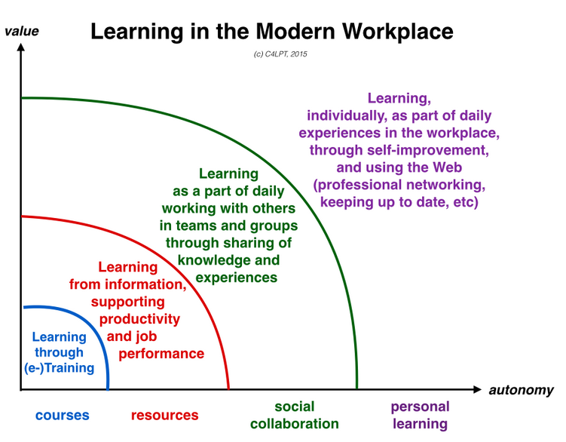
MICROLEARNING
PROFESSIONAL LEARNING
PROFESSIONAL DEVELOPMENT
TEACHER
TRAINING

Slide 27
WHAT NEEDS TO BE DONE
There needs to be transition from Professional Development to Professional Learning;
Access to learning opportunities by teachers need to be expanded
More support to be provided to teachers on ability to diagnose and assess learning deficits and to put remedial measures in place;
Time needs to be created within the school timetable for teachers to engage in their own learning and development;
Opportunities need to be created for teachers to collaborate more through locally-based Professional Learning Communities;
Teachers must be incentivised to engage in professional learning
Development of teachers must focus on their well being as well as what happens in the classroom. Context is important.

Slide 28
TEACHER PROFESSIONALIZATION
STATUS
Morale and Personal worth
PRACTICE
Professional Capital( Teacher Agency)
ACCOUNTABILITY
Bureaucracy
Profession
Conduct/ Behavior
Image
Recognition and Appreciation
Opportunities for growth
Learner/Parents

Slide 29
PROFESSIONAL CAPITAL
Fullan & Hargreaves (2012)
SOCIAL CAPITAL
DECISIONAL CAPITAL
HUMAN CAPITAL

Slide 30
OPPORTUNITIES
Platforms for delivery
Institutes and centers
Online TD Platform
SACE
Grant for management of CPTD
Skills Levies
Management of skills budget
ELRC Processes
Revisit ELRC CA 4 of 2003 to address Career Pathing
Time during school holidays
CPTD Management system in place

Slide 31
RECOMMENDATIONS
Locus of Control back to school
Appoint more Departmental Heads
Address criteria for appointing Principals and SMT
Create time for PD
Time for PD to be created in school time table
Use part of school holidays for PD
Strengthern capacity for SMTs to support teachers and onsite capacity building
Encourage Teacher Collaboration at local level
Career-pathing
Re-visit collective agreement no.4 of 2003 to address career-pathing issues.
Opportunities to have mentors and coaches in schools
Encourage individual learning through online TD Platform
More teachers to support their peers

Slide 32
RECOMMENDATIONS Cont..
Strengthen Initial Teacher Training
Create more opportunities for supervised practice teaching during initial training
Incentivize Teachers
Amend appointment/promotion requirements into SMT to take into account issues of performance, including learner performance
Repositioning of SACE
Re-visit the concept of teacher licensing to create incentive for participation in CPTD
Use CPTD grant to invest more in ICT systems for proper coordination
Monitor quality of programs tor Initial Teacher Training
Align programs with sectoral expectations
Only Teachers who shall have completed a certain number of PD Points(licensed Teachers) to be considered for appointment into promotional posts
A functioning and reliable system of CPTD points to be enforced
Strengthen content knowledge and pedagogic competence in programmes

Slide 33
RECOMMENDATIONS Cont..
Protect Funding for CPTD
70% of the 1% for Skills levy to be protected and ring-fenced
Strengthen partnerships
Strengthen Teacher Union Collaboration by allocating resources from Skills Levy
Strengthen structures and platforms for CPTD
Capacitate structures for CPTD at all levels of the system( NICPD, PTDIs, DTDCs)
Capacitate oversight structures for CPTD e.g NTEDC, PTEDCs
Strengthern and support PLCs
Atleast 80% of the 50% to be used for school based Educators
Encourage teachers to belong to professional associations
Partner with Universities to develop short courses
More collaboration with ETDP SETA
Invest more in ICT Systems

