Slide 1
PURPOSE OF THE CONFERENCE
20 April 2023

Slide 2
The Teaching Profession in Our Hands. “Our Voices and Plight Matter”

Slide 3
The Plight of Teachers Matters
After effects of COVID-19 on health, wellbeing, emotions.
Additional responsibilities, increased workload, bureaucratic accountability.
Violence against teachers in and outside the school environment
Scripted lessons and limited autonomy to exercise professional judgement and decisional capital.
Overcrowding classrooms, big class sizes and teacher people ratio.
Poor working conditions, especially multigrade teachers and ECD practitioners.
Inadequate and inequitable provisioning of continuing professional development and learning.
Recurring digital divide

Slide 4
Teachers/Practitioners are viewed as the unsung heroes of the education sector across the globe.
They made all other professions, yet they remain unsung.
One educational author said…
“If the future of our world rests on children, and the children’s future rests on the teachers, then surely their voices must be heard”

Slide 5
WORLD TEACHERS’ DAY THEME 2022 REMINDED US ALL THAT – TRANSFORMATION BEGINS WITH TEACHERS

Slide 6
UN / UNESCO TRANSFORMING EDUCATION SUMMIT 2022 - ACTION TRACK 3: Teachers, Teaching, And The Teaching Profession
Teachers are the epicentre of achieving learning outcomes, educational goals, and transforming education;
Quantity and Quality teaching force;
Recognised and supported teaching profession;
Continuing professional development and learning;
Improved status and standing of teachers and the teaching profession, including esteem and prestige; and
Improved working conditions in the profession

Slide 7
TEACHER LEADERSHIP VOICE, AGENCY, SPACE, TRUST, EFFICACY, PROFESSIONAL AUTONOMY AND PROFESSIONAL JUDGEMENT BY TEACHERS FOR TEACHERS MATTER TOO “the capacity and power to act, to affect/ influence matters, to make decisions and choices, and take stances”

Slide 8
CONFERENCE SUB-THEMES
4IR, Competencies & Skills for the Changing World
Leadership and Management
Ethical Standards in the Teaching Profession
Early Childhood Development (ECD)
Inclusivity Teacher Wellbeing & Safety and Security
Curriculum & Assessment
Continuing Professional Development

Slide 9
CONFERENCE OBJECTIVES
To discuss issues pertaining to teachers’ professional status, standing, esteem, and prestige.
To discuss measures for enhancing teaching and learning, as well as continuing professional development, learning and support.
To engage on the 4IR, digital learning, as well as sharing experiences on the role of modern technologies and artificial intelligence in teaching and learning and schools.
To identify measures for creating inclusive, safe, and secure school environments, as well as promoting teacher wellbeing.
To discuss measures for heightening the professionalisation of the Early Childhood Development sector.
To explore how the school leaders and managers’ roles could be supported to contribute meaningfully to learning outcomes and school improvement.
To appreciate and acknowledge our teachers – Participation in Continuing Professional Development, Women in Leadership and Management.

Slide 10
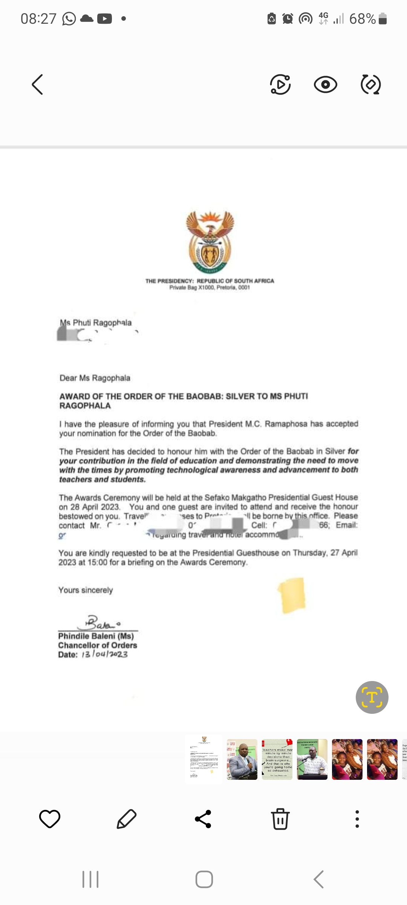

Slide 11
THANK YOU VERY MUCH
Ella Mokgalane
083 380 9879
ella.mokgalane@sace.org.za

