Slide 1
Ethical Pofessional Standards for Educators

Slide 2
SACE Inaugural National Teachers’ Conference 20-21 April 2023
Presented by
Daya Chetty
IDSO- Department of Education

Slide 3
What is Ethics?
Derived from the Greek word “ethos”, which means “way of living”, ethics is a branch of philosophy that is concerned with human conduct, more specifically the behaviour of individuals in society.
Ethics examines the rational justification for our moral judgments; it studies what is morally right or wrong, just or unjust.

Slide 5
Ethics, Education and Leadership
Ethical Leadership
What ethics do leaders model?
Leadership with Ethics in Mind
What should we consider when leading others?
Leadership for Ethics
How do we teach others? (staff/students)
Notes:
Ethical Leadership
A number of professional codes inform this topic
We’ve included a few in your resources.
Ultimately, you need to develop a personal code as well.
Leadership with Ethics in Mind
Look at some ethical frameworks—or paradigms—that people commonly use to decide what “ethical” practice is.
How can we use this information to help us lead more effectively
What happens when we fail to acknowledge the moral or ethical values are shaping people’s behavior or beliefs?
Leadership for Ethics in Education

Slide 6
Why do ethics matter?
Civic mission of schools “For democracy to flourish, public education must play a central role in promoting responsible moral action that serves the common good.” –Charles Haynes, First Amendment Center
“To educate a person in mind and not in morals is to educate a menace to society.” –Theodore Roosevelt
Notes:
Jong Zhao told administrators at this year’s AASA conference in San Fransisco:
“Pushing for high math and science scores will not help the United States remain a global economic leader; it will only ‘discriminate against other talents.…”
He told administrators that in order to thrive in this new interconnected world requires having global tolerance and strong ethical online standards.
“We need to teach our students global citizenship, teach them that global warming is interdependent on all countries, that learning foreign languages can really benefit them in the future.

Slide 7
Why do ethics matter?
Part of our leadership code An education leader promotes the success of every student by acting with integrity, fairness, and in an ethical manner.
Notes:
Nevertheless, few educator prepraration programs incorporate any study of ethics into the curriculum. (Beck & Murphy, 1994)
The master’s degree courses most often taken by aspiring prinicpals and superintendnetsz offer no formal training in ethical decision-making (shapiro & Stefkovich, 2001)

Slide 8
Why do ethics matter?
Make us more effective as leaders “Ethics is ultimately about relationships. …No matter what definition of ethics you examine, ethics is not primarily about standards, rules, and sanctions in isolation from society. Ethics is about people and their relationships with one another.” “What brought down Anderson [Accounting] was not law. It was ethics…or more exactly, a lack of public trust. When Anderson could no longer be trusted to resist unethical behavior… it effectively lost its most important resource: credibility. …Negative ethics equals negative business.
Notes:
Context—Anderson Accounting was the firm that represented Enron (and was caught shredding its corporate records).
This is an example of a "social entrepreneurial" model of leadership.
This model recognizes a social problem and uses entrepreneurial principles to organize, create and manage a venture designed to effect social change. Whereas business entrepreneurs create and transform industries, measuring performance in terms of profit and return on investment, social entrepreneurs act as change agents in order to improve systems. These nonprofits seek to generate "social value" and measure their success in terms of the impact they have on society.
The National Council; of Professors of Education Administration has published a study called “Ethical Administrators: Tools for the Trade”
In it, the authors contend that with increasing levels of accountability and complexity for school administrators, gaps in ethical training must be addressed. They paint a portrait of an ethical administrator—one who not only knows the ethical standards that are expected but also knows how to model these standards in his or her daily decisions and behaviors.
They contend that having an ethical administrator, and being able to recognize this person as such, is inherent to the succes of the school as a social entity.

Slide 9
Who decides?
Rushmore Kidder’s research identified 5 core moral values
Honesty
Respect
Responsibility
Fairness
Compassion
Rushmore Kidder, in Shared Values for a Troubled World: Comversations with Men and Women of Conscience (1994 ) and Moral Courage (2005)
Notes:
Ethical conversations can too easily be dismissed as “your values vs. my values.”
Rushworth M. Kidder, Institute for Global Ethics
Researcher and author of several books: Moral Courage, How Good People make Tough Choices and Shared Values for a Troubled World
Interviewed hundreds of individuals from around the world, from many domains, many professions. He asks: If you could help create a global code of ethics, what would be in it?
He has compared this to others’ surveys and studies (e.g. Gallup, and others) as well as organizational codes and values.
Five values keep emerging at the top of every list)
The words might differ (compassion/love/concern/kindness; respect, self-respect, tolerance; fairness, justicce;)
Says values don’t need to be imposed, but instead can be discovered.
Kidder points to three domains of ethics/morals:
Having strong values in relation to community standards (being honest in a culture that values honesty)
Skillful moral reasoning when resolving ethical dilemmas (which he defines as a situation in which two or more moral values are in opposition. E.g. Ellen’s situation in the School Administrator article we provided.)
Moral courage—to put decisions into action.

Slide 11
Who decides?
Core values for education leaders?
Honesty* (43.5%)
Respect (25.8%)
Responsibility (42.3%)
Fairness (35.3%)
Compassion (31.8%)
“Ethical Administrators: Tools for the Trade,” Edmonson et.al, TCPEA School Leadership Review, May 2007.
Notes:
The researchers of the “Tools of the Trade” report surveyed 85 graduate students currently enrolled in ed leadership programs.
Goal: to define the behaviors and characteristics of ethical administrators.
Open-ended survey asked students to describe, in their own words, the behaviors and characteristics of an ethical administrator.
Total of 58 behaviors and 63 characteristics were mentioned at least once by the students surveyed.
Several areas rose to the top—were mentioned most frequently. This became their “portrait of an ethical administrator.”
Although the labels might differ, it became clear that the core values identified in “ethical” administrators largely echo the findings of Rushmore Kidder.
Honesty mentioned by the highest number
Respect: (open-minded 17.6%; listener 16.5%))
Responsibility: (trustworthy/reliable/consistent 23.5%; Professional/knowledgeable would add an additional 24.7%))
Fair: Consistent would add another 23.5%
Compassion: Caring/considerate; positive would add 31.8%; kind/friendly would add 17.6%)
FYI—some unique behaviors and characteristics that emerged for education administrators:
Positive (31.8%)
Professional/knowledgeable (24.7%)
What emerged was a survey tool leaders could use to examine and compare perceptions of various stakeholders of what behaviors are valued with respect to ethical behavior. We’ve included it in your resource packet.
Take away…we’ll get to that in a minute.

Slide 12
Framing the issue
Ethical paradigms
Ethic of Justice
Ethic of Critique
Ethic of Care
Ethic of Profession
Personal Code
Notes:
Joan Shapiro and her colleagues have answered the question “whose ethics” by identifying several models that have traditionally influenced educational leadership. These paradigms include ethics from four viewpoints.

Slide 13
Framing the issue
Ethic of Justice
Rights of teachers/responsibilities)
Policies (sect. 17 and 18)
Law (understanding and application)
Ethical dilemmas resolved by rules, fairness, equity, and justice
Equity (EEA - legal) and equality (fair and unfair discrimination)
What circumstances justify exceptions
(early leave – discretion not a right)
Individual rights vs. community good
(balancing of rights)

Slide 14
Framing the issue
Ethic of Critique
Awakens educators to inequities in society.
Who makes law? (parliament/DBE)
Who benefits? (learners/teachers/parents)
Who has power? (Principal/ Depart.)
Who is silenced? (staff/ learners/principal/ parents)
Ethical dilemmas resolved by asking how all children can be enabled to overcome past inequities to grow, learn and achieve.

Slide 15
Framing the issue
Ethic of Care
“The first job of schools is to care for our children.” Noddings, 1992 (pastoral care)
Who is hurt?
What are long-term effects of the decision? (setting a precedent)
Caring, concern, connection
Decision-making requires leaders to consider multiple voices. (listen to your staff at times they have better solutions.)

Slide 16
Framing the issue
Ethic of Profession
Education, unlike law, medicine, dentistry and business, require little or no formal training in ethics.
Codes of Ethics authored by professional associations have filled that gap somewhat.
SAPA
Code of Ethical Relationships (SACE)
EDUCATION LAW HANDBOOK (JUTA)
EMASA
Best when examined in light of personal code of ethics.
Notes:
From Shapiro & Stefkovich (page 20)
Greenfield (2004) pointed out that such preparation could “enable a prospective principal of superintendent to develop the attitudes, beliefs, knowledge and skills associated with competence in moral reasoning. Stressing the importance for such preparation, Greenfield left us with a warning of sorts:
“A failure to provide the opportunity for school administrators to develop such competence constitutes a failure to serve the children we are obligated to serve as public educators. As a profession, educational administration thus has a moral obligation to train prospective administrators to be able to apply the principles, rules, ideals, and virtues associated with the development of ethical schools.”
Professional ethical codes might be defined as “an articulated statement of role morality as seen by members of the profession.”
Serve as guideposts for the profession.
Tend to be limited in their responsiveness in that they are somewhat removed from day-to-day personal and professional dilemmas educational leaders face.
Become richer when educators and leaders develop their own personal codes of ethics: In light of their experiences and expectations; perceptions of right and wrong; who they are as professionals/humans; how decisions are made; why decisions are made.

Slide 17
Final Words
The importance of having an ethical administrator…is inherent to the success of the school as a social entity:
Society or we do not invent principles; they are the laws of the universe that pertain to human relationships and human organizations. … To the degree people recognize and live in harmony with such basic principles as fairness, equity, justice, integrity, honesty, and trust, they move toward either survival and stability on the one hand or disintegration and destruction on the other. –Covey, 1992

Slide 18
And one more…
“Be your most creative when making ethical judgments, not when rationalizing immoral behavior.” –R. Adler 1998
Let’s practice

Slide 19
What is the code of ethics for educators South Africa?
The Code tells us as educators that “we ought to”: act in a proper and becoming way such that our behaviour does not bring the teaching profession into disrepute; acknowledge, uphold and promote basic human rights, as embodied in the constitution of South Africa; exercise authority with compassion.

Slide 20
What are the list of ethics for teachers?
Teachers must model strong character traits, including perseverance, honesty, respect, lawfulness, fairness, patience, and unity.
As an educator, teachers must treat every student with kindness and respect without showing any favouritism, prejudice or partiality.
27 Jul 2020

Slide 22
ATTRIBUTES OF A GOOD TEACHER

Slide 23
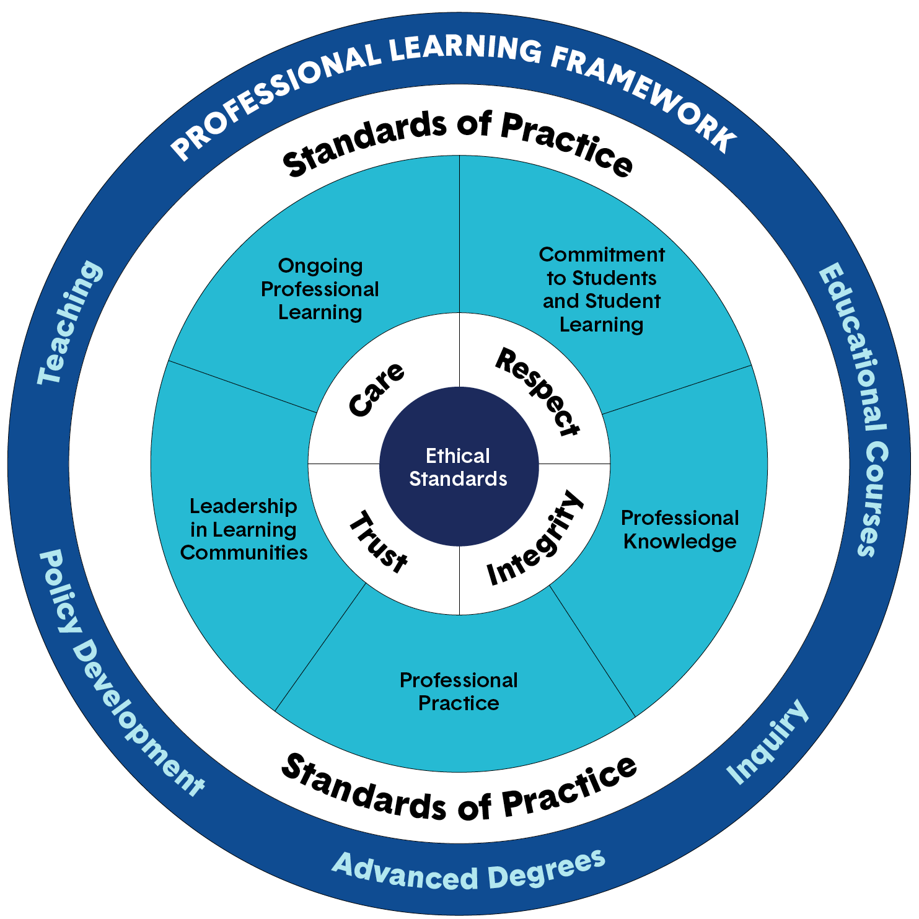
The Teacher As a Professional
DAYA CHETTY

Slide 24
Profession—a vocation or occupation requiring advanced education and training and involving intellectual skills. The work is based on unique knowledge and skills grounded in research and practice in the field.
Professional— has completed higher education, usually at the advanced level, and engages in and is worthy of the high standards of a profession.
Professions and Professionals answer to a written code of ethics.
“Teaching is a profession laden with risk and responsibility that requires a great deal from those who enter into it.”
--John I. Goodlad

Slide 25
A Professional Educator Should:
WORK in a collegial manner with colleagues
ASSOCIATE with and learn from positive mentors
JOIN a professional organization
CONTINUE TO LEARN through classes, workshops, conferences, in-service meetings, books, journals, tapes, and advanced degrees.

Slide 26
The Four Beliefs of an Effective Teacher
It is the teacher who makes the difference in the classroom.
By far the most important factor in school learning is the ability of the teacher.
There is an extensive body of knowledge about teaching that must be known by the teacher.
The teacher must be a decision maker able to translate the body of knowledge about teaching into increased student learning.
-- Madeline Hunter

Slide 27
DRESS CODE What’s OUT
Running shoes are for jogging or mall-walking.
Sweatshirts are best left for exercise.
T-shirts are for the beach.
Stretch slacks are unbecoming.
Bold prints, plaids, colors are no no’s.
Trendy clothes do not establish authority and should be left to students.
Anything blue denim should be worn only on Saturdays.
Excessive jewelry is distracting.
--Harry Wong

Slide 28
What’s IN
Bright colours are enjoyed by primary students.
Soft muted tones are recommended for secondary school.
Men can’t miss with suits and ties or a sweater or coat and a dress shirt.
A career dress or suit is appropriate for women.
Clean clothes convey good hygiene.
Pressed clothes tell people you care.
Neat, cleanly tailored career clothes establish authority.
Career clothes prepare students for future in the competitive global world economy.
--Harry Wong

Slide 29
SOCIAL MEDIA
Use of social media platforms
facebook, whats app, twitter, instagram, etc. - sharing of messages
School groups for educators and learners - code of good practice and controls - admin ONLY!
Use of mobile phones in classes by educators and learners during lessons. - School Policy.
POPIA Act

Slide 31
SAFE TRAVELS AND BEST
WISHES!
dayachetty0007@gmail.com
072 129 7358

